Slide 1
Foundations of Contemporary Leadership
Module 1
This project has been funded with support from the European Commission. This publication [communication] reflects the views only of the author, and the Commission cannot be held responsible for any use, which may be made of the information contained therein.

Slide 2

WELCOME TO SHINE
The SHINE project www.shineproject.eu upskills women with the knowledge and behaviours necessary to confidently and successfully transition into leadership roles in their third sector /community workplace.
The SHINE Strengthening Female Community Leaders Open Education Resources have been carefully designed to be used by VET organisations across Europe and delivered to the women in the third sector.

Slide 3
CONTENTS OF MODULE 1
01
Understanding the Context
02
Contemporary Approaches to Leadership
Learners will find out why it is important to learn about leadership with successful outcomes in their sector. They will learn about leadership types, examine skills and traits needed for leadership and look back at how the leadership is done in the community and NGO setting.
Communication tactics will be taught towards the end of the module, concluding with the well-known examples of female leaders and learnings showing why our learners can become successful leaders.
03
Skills and Traits of a Good Leader
04
Using Design Thinking for Third Sector Leadership
05
How to Communicate to Diverse Groups as a Leader
06
Remembering Women Who are Great Leaders

Slide 4

01
Understanding the Context

Slide 5
WHAT IS THE THIRD SECTOR?
NGO’s
Cooperatives
Social Enterprises
Voluntary organisations
Mutuals
Third sector is a term used to describe the range of organisations that are neither public sector nor private sector. It includes voluntary and community organisations (both registered charities and other organisations such as associations, self-help groups and community groups(NGO’s), non-for-profits, social enterprises, mutuals and co-operatives*
* Co-operative and mutual enterprises (CMEs) form when people come together to achieve an objective that they could not achieve alone. They are social businesses because they put people at the centre of the organisation.

Slide 6
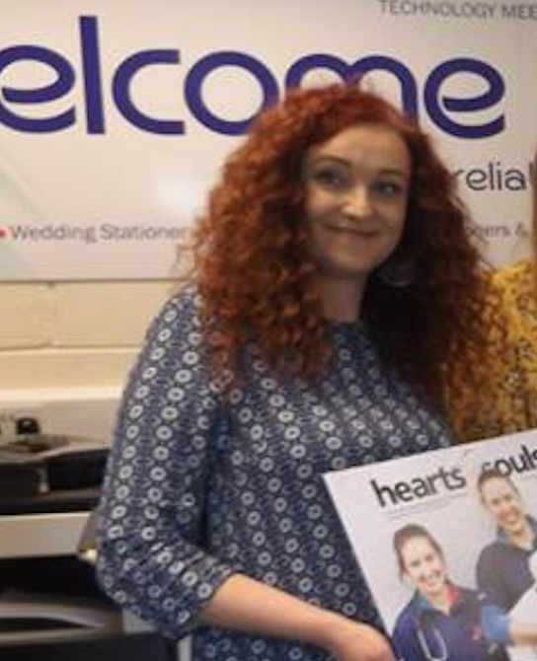
LET’S MEET DEBORAH TIERNEY from Triest Press
From small beginnings in 1987, Triest Press has grown to become a thriving social enterprise providing a professional digital print service, coupled with meaningful employment for people with intellectual disabilities. Triest Press is a member of the Irish Social Enterprise Network of Ireland.
Deborah Tierney’s role in Triest covers everything from fundraising, marketing, to building a unique culture in the organisation. Thanks to her engagement, and the engagement of Triest team, this 3rd sector organisation has managed to thrive even through COVID times.
Read about them here: https://www.triestpress.ie/about-us/

Slide 7
THIRD SECTOR NEEDS - SOCIAL CAPITAL AND THE ECONOMY
Civil society has a much bigger role to play in the future of the EU than the
current policy landscape reflects. The sector is vital to the effective functioning of
government and markets, and it makes a range of more direct contributions to a thriving society.* A 2021 study of social capital across 21 EU countries highlights the societal impact of ‘bridging’ social capital or connections between heterogeneous social groups. This form of social capital is linked directly to participation in civil society organisations.*
This means the third sector will need powerful and skilled leaders to navigate towards the future, especially after difficulties imposed by COVID.
*SOURCE: REPORT - Third pillar, not gap filler June 2021 Max Williams

Slide 8
WOMEN IN THIRD SECTOR – CURRENT SITUATION ACROSS EUROPE
There is growing visibility and discourse surrounding female leaders in the third sector but gender equality at the leadership level is “happening too slowly and unevenly.”
Women remain absent from key positions to shape access to and control resources. In the UK and Ireland, women make up more than two-thirds of the voluntary sector. However, women account for only 37% of managers, 30% of board members and 19% of senior executives. Italy faces similar statistics.
Despite this sector valuing social justice, there is significant gender inequality and barriers to leadership in the sector.
Sweden is a gender equality role model from which we can transfer learning.
Source: EUROSTAT

Slide 9

Contemporary Approaches to Leadership
02

Slide 10

THE POWER FLOWER
The middle of the flower is the ‘centre of power’. Third sector leaders at all times know who holds the power in the matters they operate with
Petals represent influencers on the centre of power, for example, advisers, or the media. Who are influencers in your cause?
Grassroots is a because their needs are at the root of communities commonly used word to describe the target groups of initiatives. Who are your grassroots?
You are the stem that represents leadership. Leadership in third sector is arguing for a particular cause, often trying to influence particular public decisions, for example, policies. In this case, it is third sector leadership that aims to get the voice of the ‘grassroots’ heard by the influencers and the centre of power.
Power
Influences
Leader
Grass roots

Slide 11
The 5 main types of Contemporary Leadership
04
02
05
01
03
Authentic
Leader-member exchange
Quantum
Transformational
Servant

Slide 12

01
Transformational Leadership
The transformational leadership approach highlights the importance of the leader’s charisma, inspirational motivation, intellectual stimulation, and individualised consideration as methods of influence.
Transformational leaders lead others by aligning employee goals with the leader’s goals. Thus, employees, volunteers and others working for transformational leaders start focusing on the organisation’s well-being rather than on what is best for them as individuals.

Slide 13
Transformational leaders can become change-makers who not only protect their rights and impact their communities, but inspire their peers to do the same.

Slide 14
TRANSFORMATIONAL LEADERSHIP
CHARISMA
INSPIRE
STIMULATE
ENCOURAGE
CARE
Create confidence, commitment, admiration
Create a vision that is inspiring to others
Challenge organisational norms and status quo
Encourage creative thinking
Use individualised consideration, care about each follower

Slide 15
The key factor is trust!
Trust is the belief that the leader will show integrity, fairness, and predictability in his or her dealings with others.
When leaders demonstrate transformational leadership behaviours, followers are more likely to trust the leader.

Slide 16
The Five Practices of Exemplary Leadership
Kouzes and Posner created their Five Leadership Practices model after researching people's personal experiences of excellent leadership. From this, they claimed that "...good leadership is an understandable and universal process..."
Inspire a Shared Vision
Challenge the Process
Enabling Others
Encourage the Heart
Model the Way
Work on your vision
Enlist others in a common vision by appealing to their values, interests, hopes and dreams.
Foster collaboration with cooperative goals and build trust. Delegate power, develop their competence and offer visible support.
Recognise individual contributions to the success of the project.
Celebrate team accomplishments regularly.
Set an example
Define the shared behavioural standards Achieve some small wins to build momentum
Search out challenging opportunities to change, grow, innovate and improve.

Slide 17

02
Leader-member exchange (LMX)
The Leader-Member Exchange theory proposes that the type of relationship leaders have with their followers (members of the organisation) is the key to understanding how leaders influence others.
Leaders form different types of relationships with their employees, volunteers and stakeholders. In high-quality LMX relationships, the leader forms a trust-based relationship with the member. The leader and member like each other, help each other when needed, and respect each other. In these relationships, the leader and the member are each ready to go above and beyond their job descriptions to promote the other’s ability to succeed.

Slide 18
High LMX relationships
Low LMX relationships
More committed
Higher levels of clarity about what is expected
Better performance
Higher role/job satisfaction
Mistrust, feeling of unfair conditions
Unequal reward system
Non-supportive environment

Slide 19
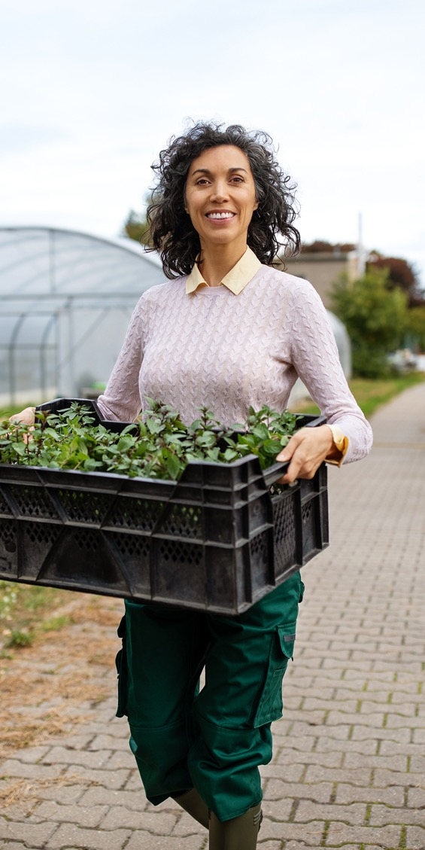
03
Servant Leadership
Servant leadership is a leadership approach that defines the leader’s role as serving the needs of others, with the primary mission of the leader being to develop employees, volunteers and others and help them reach their goals.
Servant leaders put the needs of others first, understanding their personal needs and desires, empowering them, and helping them develop in their own pathways in careers or voluntary service
Servant leaders feel an obligation to their employees, customers, and the external community.
Happiness is seen as a goal in itself, and servant leaders sometimes sacrifice their own well-being to help others succeed.

Slide 20
Servant Leadership
A clear focus on a moral compass
genuinely concerned about the broader community
Participation
humility
INTERPERSONAL HELPING
Climate of fairness
self-sacrifice
employee citizenship
serving the community
community development
positive impact on employee commitment
focus on ethics

Slide 21
Servant leadership is a tough transition for many managers who are programmed to put their own needs first, be driven by success, and tell people what to do.
The best thing to get started with this approach is to focus on humility!

Slide 22
HOW TO ACHIEVE SERVANT LEADERSHIP?
Don’t ask what people can do for you. Think of what you can do for them. Your job as a leader is to be of service to them.
How can you relieve their stress? Protect them from undue pressure? Pitch in to help them?
Think about creative ways of helping ease their lives
Help your team reach their goals. This involves getting to know them. Learn about who they are and what their values and priorities are.
Be humble. You are not supposed to have all the answers and dictate to others.
Be open with your team. Ask them questions. Give them information so that they understand what is going on.
Find ways of helping the external community.

Slide 23

Read more on servant leadership
Greenleaf Center for Servant Leadership
https://www.greenleaf.org/

Slide 24

04
Authentic Leadership
Effective leaders have to stay true to themselves. The authentic leadership approach embraces this value: Its key advice is “be yourself.”
Think about it: We all have different backgrounds, different life experiences, and different role models. These trigger events over the course of our lives that shape our values, preferences, and priorities. Instead of trying to fit into societal expectations about what a leader should be, act like, or look like, authentic leaders derive their strength from their own past experiences.
Thus, one key characteristic of authentic leaders is that they are self-aware.

Slide 25

Authentic leaders are introspective. They understand where they are coming from and have a thorough understanding of their own values and priorities. Secondly, they are not afraid to act the way they are, they have high levels of personal integrity. They behave in a way consistent with their values. As a result, they remain true to themselves. Instead of trying to imitate other great leaders, they find their own style in their personalities and life experiences.
Understanding oneself +
self-reflection + feedback from others

Slide 26
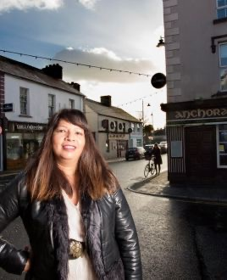
LET’S MEET LOLA GONZALEZ FARRELL
NCBI and Leitrim International Community Group
Lola Gonzalez Farrell has worked as an NCBI Retail Manager - Working for People With Sight Loss since 2016, where she manages a team of staff and volunteers. In 2017, Lola has developed her personal leadership style, joined the Leitrim International Community Group which works to promote inclusion and integration in the county. From this, she joined the Leitrim Local Community Development Committee as a community representative for Leitrim’s migrant community. She believes the work of the community group has played an important role in changing people’s perceptions of migration and diversity. Racism is a problem in Ireland, says Gonzalez, but it’s “minimal” in Carrick-on-Shannon. “I feel people are more welcoming in this community now”. Read about her work here:

Slide 27

05
Quantum Leadership
Quantum leadership is the process of leading from the future. Since the outside forces, are not in control of any organisation & are unforeseen and complicated, management needs to realign their internal culture as well as operational strategies to address the same.
Quantum leaders envision many possible outcomes of a situation or problem and explore, with the greatest possible range of input from others, many possible ways of addressing them.
Quantum leaders learn how to work with and thus thrive on uncertainty and instability. They know that creativity and innovation are best nurtured at “the edge of chaos.”

Slide 28

KEY TAKEAWAY
While each leadership approach focuses on a different element of leadership, effective leaders will need to change their style based on the demands of the situation, as well as utilising their own values and a moral compass!

Slide 29

Skills and Traits of a Good Leader
03

Slide 30


What Makes a Contemporary Leader?
Work-life balance: set personal priorities and then strategise how to negotiate them with the organization.
Giving back is a priority. You got here on somebody’s shoulders somewhere. You need to be able to say, ‘This is what I took, and this is what I’ve given.
Understand balance
Practice generosity
Leverage the team IQ
Serve as a public role model
“You’re always, always smarter when you (listen to) the voice of the people around you,” she says. Solicit opinions from a wide range of people well before a project is due. It will cut down on the work – and the changes –at the end.
As a leader, you are a public figure and people will be interested in what you say and do
SOURCE: Finding Your Followers: What Makes a Contemporary Leader?, Alicia W. Roberts, Plousha Moore

Slide 31
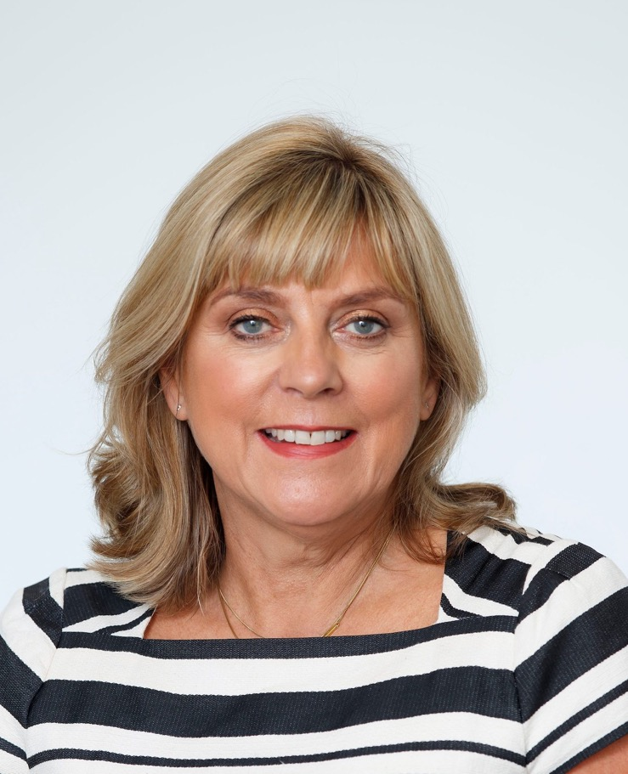
LET’S MEET FIONA BOLGER
CEO of Spinal Injuries Ireland (SCI)
Fiona’s leadership style is based on practising generosity and serving as a role model in the third sector. Even though a complete novice in terms of biking, Fiona has undertaken a biking quest Paris2Nice, 746km in 6 days, to fundraise for Spinal Injuries Ireland and motivate her team.
She says: “In 2014, I was fortunate to be given the opportunity to work with people who had sustained a life-changing spinal cord injury (SCI) and their families when I became the Chief Executive of SII. A SCI is described by the World Health Organisation as one of the most devastating injuries that a person can sustain & three people sustain a SCI in Ireland every week. I see first-hand the positive impact of the supports & services that Spinal Injuries Ireland provides. It will come as no surprise to hear that public services for people with disability are very scarce around the country and many people rely on SII to provide these services”

Slide 32
SELF ASSESSMENT ACTIVITY
Take a sheet of paper and start writing, try to answer these questions!
Are you someone who:
Wants to improve your organisation? Elaborate
Has something to contribute? Elaborate
Doesn't wait around for someone else to get the job done? Elaborate

Slide 33

Let’s get to know
Characteristics of good third sector leaders

Slide 34
Qualities of a Third Sector Leader
To trust you, people have to know that you say what you believe and act accordingly. If people trust you, they may follow you to the ends of the earth
It's okay to shake in your boots, but someone has to go slay that dragon, and it might as well be you. Leadership means that you show others the way through the dark, scary, forest. Go ahead and speak the truth--even when it's not popular
You have to stick with a task through the good times and the bad. Your commitment will serve as a model
People will follow you if they know you care about them and about others. The greater your ability to care about all types of people, the more confidence they will have in you
Integrity
Courage
Commitment
Empathy

Slide 35
Qualities of a Third Sector Leader
Every situation will call for a different response. Be ready to change and come up with new solutions.
Develops self awareness and gains an understanding of own needs in order to achieve happiness.
Maintains a positive attitude, builds resilience and patience in achieving own personal objectives
Demonstrates gratitude for opportunities and makes positive contributions to society. Sets an example through personal integrity, empathy, compassion and respect for others
Clearly sees what needs to be achieved, sets clear objectives for the future and aims towards progress
Creativity
Builds Self
Builds Others
Has the Vision

Slide 36
Good Habits of Successful Third Sector Leaders
Maximize Individuals’ Strengths
Balance the Needs of the Group
Mobilize Others
Work as a Team
Pitch In
Work with employees and volunteers.
Maximize talents.
Balance everyone’s needs focused on the work that needs to be done.
Try to get more community members on board.
Form a team.
Who has the same interest?
Offer support to get support.
Do the work.
Lead by example.

Slide 37
Good Habits of Successful Third Sector Leaders
Practice Stewardship
Be responsible
Recruit and Mentor New Leaders
Cherish the physical community.
Fix, repair, reuse resources.
Be accountable to your peers.
Who are you doing this for?
Share the knowledge.
Think how to sustain the cause.

Slide 38

04
Using Design Thinking for Third Sector Leadership

Slide 39
Design Thinking
Design thinking is a human-centred approach to creating solutions, ideas and why not – LEADERSHIP.
Third sector leaders seek to create innovative projects and to incorporate transformational changes into under-represented and under-served communities.
Design thinking can help!

Slide 40
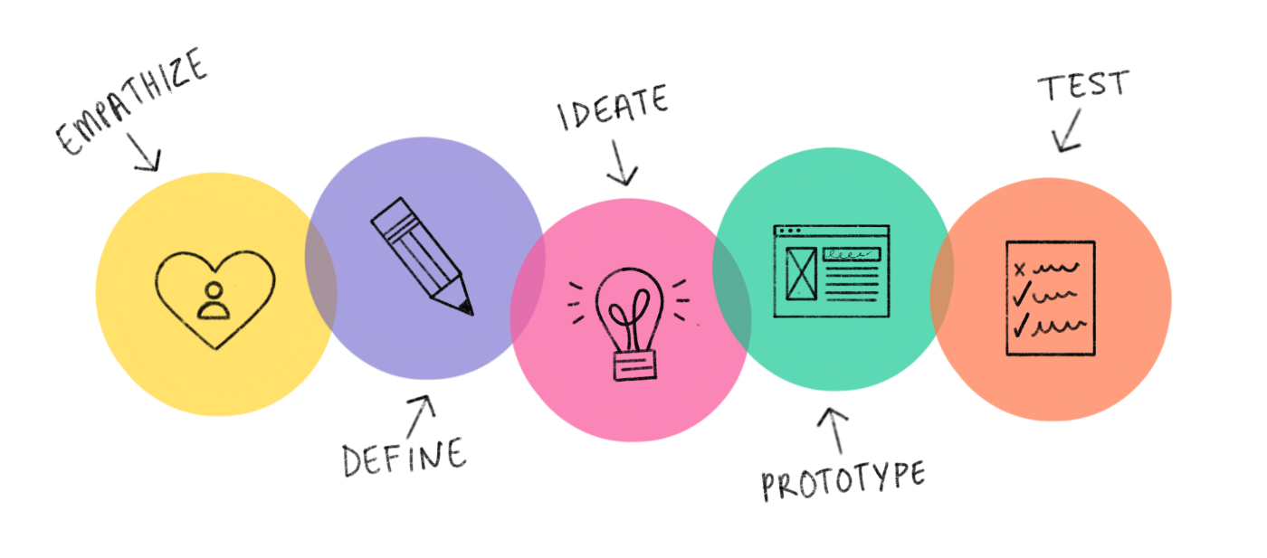
Design thinking and third sector leadership are a good match
The DESIGN THINKING PROCESS relies on social collaboration, human-centered innovative activities, visualized ideas, and social strategy determination.
The above are the phases of the process.

Slide 41
Design Thinking and Third Sector Leadership
As a leader, who do you empathise with?
What problems can you define, what is your mission, purpose?
Can you collect ideas, meaningful to the people you need to empathise with and whose lives you will impact?
Can you create a solution, idea? Describe it!
Can you try out your idea/solution? Does it work, does it help? Why? What’s good, what needs fixing?
Can you fix it? How?

Slide 42

Ask a good question.
Get close to the lives of those you are trying to serve.
EMPATHY
Understanding the problem that you are trying to solve
Understand their experiences and motivations
Observing, engaging and empathizing
Set aside your own assumptions about the world

Slide 43
DEFINE
Reframing problems,
Seeing Opportunities
Analyse your observations and synthesise them in order to define the core problems
Problem statement in a human-centred manner
Help your team narrow in on great ideas
“How might we.."

Slide 44
IDEATE
Bring together perspectives and strengths of your team members
"think outside the box"
Generate a large quantity of ideas that the team can then filter
Get obvious solutions out of your heads
Uncover unexpected areas of innovation

Slide 45
PROTOTYPE
Build to think and launch to learn
Simple experimental model of a proposed solution
Quick and rough — useful for early-stage testing and learning
Exploring their real-world impact
Bringing conceptual or theoretical ideas to life

Slide 46
TEST
Reveal insights that redefine the problem
Inform the understanding of the users
Can be undertaken throughout the progress
Feed into most stages of the Design Thinking process

Slide 47
SIMPLE GOAL SETTING
Leaders have dreams, and dreams are goals
NAME:
GOAL START DATE:
COMPLETION DATE:
MY GOAL:
OBSTACLES I MAY ENCOUNTER:
__________________________________________________________________________________________
STEPS TO REACHING MY GOAL:
_______________________
_______________________
_______________________
_______________________
2 THINGS THAT SAHLL HEL ME REACH MY GOAL:
1. ________________________
______________________________________________________
2._______________________________________________________________________________
Use the form on the left side to define your goals
Hold yourself accountable
Plan to reward yourself
I WILL KNOW I HAVE REACHED MY GOAL BECAUSE:
________________________________________________________________________________________
____________________________________________

Slide 48
01
What is your goal?
Being an
Efficient
Leader
02
What do you know, that helps reach that goal?
03
What problems are you facing?
Set up your leadership plan
Base your plan around actions needed to tackle the issues!
Write these actions down
What are the possible solutions?
04
05
What strengths and opportunities can you detect?
06
What are the main actions of the best solution and who can help you implement them?

Slide 49

How to Communicate to Diverse groups as a Leader
05

Slide 50
The Scope of Diversity
When we think of diversity, we must realise that people can be diverse in many ways. In fact, we all differ from one another. The most common ways we seem to think about diversity is in terms of what we can identify with easy, or in terms of how one identifies for example race, sexuality/gender. However, we can be different in terms of our psychological traits, personalities and preferences.
We can also differ from one another in terms of how we see problems and solutions.
Leaders must keep reminding themselves of these differences and strive to celebrate them.
On the following slide, there is an illustrative example of some types of diversities, which is not final (nor can it be, since we are so beautifully diverse)

Slide 51
The Scope of Diversity
Ethnicity
Culture
Citizenship
Opinions
Politics
Heritage
Race
Gender/sex
Preferences
Abilities
Circumstances
Reactions
Personality
Solutions
Problems

Slide 52
There are TWO DIFFERENT MODELS used to approach intercultural communication:
The Classic Model assumes that each person belongs to one culture.
The Model of The Multicultural Person assume that we are all multicultural people. This means we interact in different cultures or subcultures, for example, at the football club, at the workplace, at the bank, among our family etc.
The culture and the way to interact in the football club might be different from how we interact at work or at the bank. But all cultures are part of us.
Facilitating Intercultural Communication
01
Interpersonal interactions between members of different cultures constitute intercultural communication
Our cultural identity is made up of our different experiences, norms and value systems that come into play when we interact interculturally.
02

Slide 53
Facilitating Intercultural Communication
Cultural differences can lead to all sorts of misunderstandings during communication. Here are just a few examples
How we give and receive feedback differs widely. It can be direct. Some people may be upset by direct feedback, others may not understand indirect
Making friends and acquaintances: Here too, cultures can hold different norms for entering into friendships, boundaries and situations that are suitable
How conflicts are handled and resolved can vary widely and if people are not aware of this, it often exacerbates the conflict (for example, a frank way of verbalising problems may end up offending people who are not used to this)
Decision-making: How decisions are made, and consensus is created also differs from culture to culture.

Slide 54
Practical Tips for Communicating in a Diverse Setting
Communicate clearly and explicitly
Inform yourself about the cultures of heritage of the people you communicate with
Be attentive to non-verbal communication. Write things down, use images
Be supportive and patient.
Check your assumptions
Clarity
Knowledge
Non-verbal
Supportive

Slide 55
A leader has to understand diverse styles, mentalities, personalities
Some tips..
Be a good listener. Include people. Detect excluding.
Consider different courses of action
Nourish calm voice and interaction
Use questions to lift others, never to undermine them
Detect and avoid discussions and debates used only to ‘score points’
Be willing or attempt to identify areas of common ground.
Don’t spend more time with some people, less with others, if you can avoid that.
Talk about work culture openly.

Slide 56
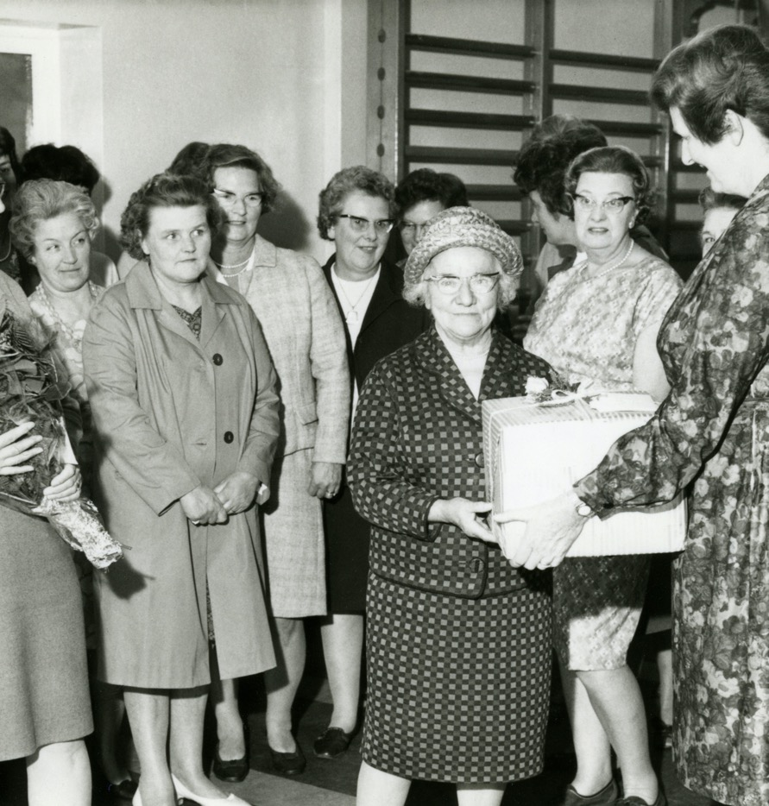
Remembering Women Who are Great Leaders and Why You Can Be One Too
06

Slide 57

WOMEN IN OUR LIVES
We do not have to go far or be famous to give tributes to women who lead before us. In our families, most often women were the pillars of the society, of the family.
Even when denied official work, or education, women were still the planners, householders, community holders, budget handlers, circular economy managers, sustainability builders. These are the titles they would hold today, let’s not deny our mothers, aunts, grandmothers, female ancestors that glory!

Slide 58
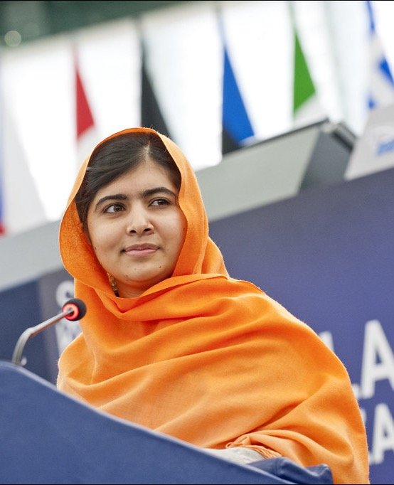
Malala
Malala lived in an area of Pakistan where women’s human rights are not recognised and are under constant threat from extreme male centred religious groups.
As a young girl she campaigned for female education in northeastern Pakistan, she was involved in teaching literacy to other young women and girls in the face of this extreme oppression.
She did this work because she passionately believed in women’s rights.
As a consequence of her activism (teaching literacy to girls) she was, at the age of 15, targeted and shot. As a leader Malala showed the world the shocking consequences for women who live under extreme oppression.
She continued to speak about the condition of women and girls after her recovery and was awarded the Nobel Peace Prize.

Slide 59

The TIME created a list of women who are changing the world: FIRSTS
CLICK ON THE NAMES BELOW TO FIND OUT MORE
Halima Aden Madeleine Albrigh Simone Askew Mary Barra Patricia Bath Samantha Bee Elizabeth Blackburn Ursula Burns Candis Cayne Hillary Rodham Clinton Eileen Collins Kellyanne Conway Dominique Crenn Stacey Cunningham Mo'ne Davis Ellen DeGeneres Gabby Douglas Rita Dove Ann Dunwoody Ava DuVernay Sylvia Earle Beth Ford Aretha Franklin Melinda Gates Selena Gomez Nikki Haley Carla Hayden Mazie Hirono Mae Jemison Young Jean Lee Maya Lin Loretta Lynch Rachel Maddow Rita Moreno Rachel Morrison Jennifer Yuh Nelson Ilhan Omar Danica Patrick Nancy Pelosi Michelle Phan Issa Rae Shonda Rhimes Lori Robinson Danica Roem Sheryl Sandberg Katharine Jefferts Schori Amy Sherald Cindy Sherman Kathryn Smith Kathryn Sullivan Lindsey Vonn Lena Waithe Barbara Walters Alice Waters Serena Williams Geisha Williams Oprah Winfrey Janet Yellen

Slide 60


YOU ARE A LEADER, HERE’S WHY
Anyone who wants to make a difference and ends up making an impact with someone, somewhere is a leader – LOLLY DASKAL, leadership coach.
Dedicate yourself to making a difference
Be sensitive to issues impacting others
Make the move – action!
Lead from within
READ THE FULL ARTICLE HERE: https://www.lollydaskal.com/leadership/everyone-see-leader/
Click above to read:
Everyone Can Be A Leader – Here’s How

Slide 61
Do you realize how many events and choices that had to occur since the birth of the universe, leading to the making of you just exactly the way you are?
A Wrinkle in Time (2018)

Slide 62

SELF ASSESSMENT ACTIVITY
Give your vision a sharper image. Turn up the focus. Set some long-term and short-term goals. That is how you carve a real path to your vision.
OVERALL GOAL
What is your 3-year goal as a community leader?
How do you get there? Set 10 measurable, realistic goals – these are your SPECIFIC GOALS

Slide 63
NEXT:
Module 2 Identifying Your Own Leadership Strengths
THANK YOU for finishing Module 1 of the Shine Open Education Resources.
We are confident you are on your path to securing a visible role in the third sector leadership. CONGRATULATIONS!
www.shineproject.eu

