Slide 1
Identifying Strengths of Female Leaders
Module 2
This project has been funded with support from the European Commission. This publication [communication] reflects the views only of the author, and the Commission cannot be held responsible for any use, which may be made of the information contained therein.

Slide 2
CONTENTS OF MODULE 2
You are well on your way to realising your leadership potential!
Even experienced leaders can benefit from this module.
If you find these topics relevant, share them with your peers, we want as many women as possible empowered to lead the third sector!
01
Strong leadership vs weak leadership
02
Understanding the key players: Leaders, managers, mentors, followers
03
Self-analysis: key questions to ask yourself to identify your strengths
04
Using your strengths

Slide 3

Continuing Our Journey…
In our first module, we discussed the different leadership styles, and we were able to carry out a self-assessment to discover what type of leader we are.
Module 2 of SHINE goes deeper into understanding and identifying the strengths of female leaders. We will define the key terminology and actors in leadership and get a thorough set of questions and explanations firstly to identify the strengths and then ideas and directions on how to use them.

Slide 4

Strong Leadership versus Weak Leadership
1

Slide 5
I believe that it sucks when people who can change the world don't, because they feel like they can’t!
I was the shyest kid in school. I'm still an introvert but I'm not shy. As an introvert, I'm able to stand on a stage with the mic in my hand, I've started my own business, I deliver training to countless entrepreneurs, I've raised thousands for charity, I'm a Trustee of a UK wide charity, I've curated a TEDx event and I've helped thousands of people to start their businesses over the last 15 years.
If I can do that, imagine what you can do!
Claire O'Hanlon, founder of the ShyPreneur

Slide 6
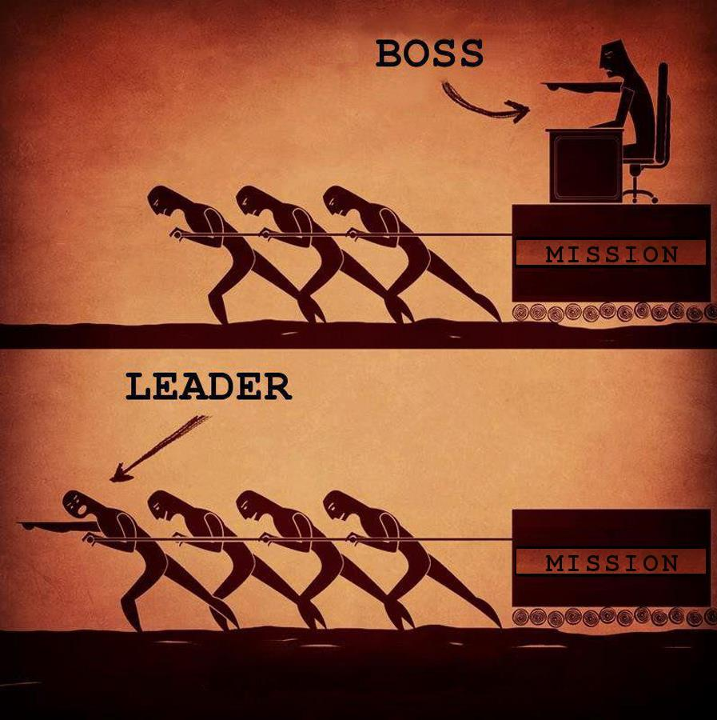
What do good/strong Leaders do differently?
It's an essential question every leader must ask themselves.
Every leader faces challenges and situations every day that test their patience, skills, and mindset. There is no magical, drama-free team. What separates strong leaders from weak leaders is how they handle the challenges they face every day.
Here we take a look at 5 situations that are handled very differently by leaders depending on their approaches.

Slide 7
5 Situations that can be dealt with differently…
Are they Challenges or Opportunities?
3
5
Managing the unknown
4
Supporting the team when needed
A new idea from your team
1
Difficult Questions from your team
Cherishing diversity
2

Slide 8
How you receive an idea/ feedback from your team…
Sample situation: An employee comes to you with a suggestion to help the team. As their leader, it's something you probably already should have done but haven't gotten around to.
1
Good Leader Approach: It's never fun to face harsh truths, but you embrace them. You recognise that your team needs to feel comfortable bringing concerns and ideas to you, so you thank them for the feedback. You also ask a few questions to be sure you understand their suggestion fully.
The Result: Your team member feels heard, and you gain a new understanding of why you may want to bump an issue or opportunity up your priority list. There should be a resolution or an action coming out of this.
Bad Leader Approach: While they may not have meant to, it feels annoying that they're trying to tell me what to do. I'm either going to ignore what they said, come up with some excuses to not act on it, or find something to criticize them about.
The Result: Your team member will learn making suggestions isn't worth the effort. Much will go unsaid, good ideas will lay dormant, and your team is likely to complain about you behind your back

Slide 9

Feedback
Feedback from your team is the lifeblood of good management and leadership; they see so much you don't get the chance to, given all your responsibilities. If you've made a few mistakes and need to work on your team being more comfortable giving you feedback, this post can help you get more feedback from them.

Slide 10
How you deal with difficult Questions from your team…
Sample situation: An employee in a long meeting asks a tough question: they zoom out and question the value of the project you're all focused on. “What made us decide to do this in the first place?"
2
Strong Leader Approach: You address the question head-on. Depending on the situation, you either explain the motivations for the decision they may not know for the benefit of the whole team, or you engage others from the team to reveal the reasoning.
The Result: Your team sees that with you, there are no silly questions, and it's safe to challenge the status quo. This helps your team explore new ideas fully and avoid missing crucial elements.
Weak Leader Approach: Shocked and offended, you think to yourself, "How dare they question my decision??" You glare at the team member and change the subject to focus back on the original discussion.
The Result: A chilling effect sweeps across your team. They know not to raise tough questions to you in meetings and just go along with things. Healthy debate is a phrase foreign to your team.

Slide 11

Team Players
It can be a challenge to manage people who have strong opinions and ideas, but they can also be your greatest asset. It is important for you to remember you are all on the same team and trying to win together. This can help you avoid feeling negative about their comments or questioning.
Learn more about the skill of curiosity and asking questions here.

Slide 12
How to Manage the unknown…
Sample situation: You have someone on your team in a role you've never done yourself. You're not familiar with all the nuances of what they do, nor their keys to success.
3
Good Leader Approach: Recognising the knowledge gap and spending time with them to learn from them and ask questions when you don't understand something. Together, you create a plan you can hold them accountable to, for the work you're less familiar with.
The Result: You build more trust with them and show that your team has a culture of humility for things they don't know. By having a plan, you can still tell how they're performing.
Weak Leader Approach: You feel a bit threatened by the hire, and some imposter syndrome, so you fake it. You pretend you know more than you do. It's their job to tell you what you need to know, right?
The Result: Communication quickly breaks down between you and the team member. Your relationship becomes adversarial as they try to manage you out of the way so they can just get their work done.

Slide 13

Growth Mindset
As important as developing the task-relevant maturity of your team is, your task-relevant maturity matters, too. Embracing the need to learn new skills and admit when you don't know is a growth mindset well worth demonstrating.
Learn more on how to level up your task-relevant maturity here.

Slide 14
How to Work with different personalities and cultures…
Sample situation: Your organisation is dabbling in remote work or recruiting from outside your region. You were raised in an area where everyone says things indirectly and gently, but your new hire is more direct.
4
Good Leader Approach: Recognising differences, you make an effort to better understand them. You try to be more explicit in your communication with them and accept it when they're more direct than you're used to. You also coach them on how to get a point across with slightly smoother edges.
The Result: While it's not easy, you work together to reach an understanding of how you each communicate. Finding some common ground works well and keeps ideas flowing.
Weak Leader Approach: Resentful of their communication style, you blame them for all communication issues. After all, you're the boss, so they should adapt to you. Using your preferred style, you drop subtle hints that they seem to be completely ignoring, much to your frustration.
The Result: You both become frustrated with each other. You feel like they're abrasive, and they feel like they can't get a straight answer from you. It leads to poor teamwork.

Slide 15

Looking in the Mirror
A healthy dose of self-awareness can help you start from a perspective of how you can do your part to improve difficult situations. Best of all, when you lead the way taking problems head-on, you make it easier for your team members to admit faults and do their part as well. Learn how to improve your self-awareness here.

Slide 16
How to be a team player and pitch in when needed…
Sample situation: A member of your team is struggling on a project. You are busy too and have several open projects and management tasks.
5
Strong Leader Approach: You recognise the importance of team playing and the impact missing a deadline can have on the entire organisation. It's not easy making time, but you find ways to carve out enough to get it done.
The Result: You complete the effort, and you see how it starts to impact your team in ways you never expected. You learn how to deal with challenging deadlines and become a better planner of your and your team’s time.
Poor Leader Approach: You pretend you don’t notice them struggle "It's extra work, and I'm sure it can wait." You let your mind run and rationalize away why helping them out doesn't apply or isn't as important as the 38 other things on your to-do list.
The Result: Your organisation misses out on the impact helping could have had. Compounding the issue, when the team member sees your unwillingness to pitch-in they start to lose faith in your willingness to listen and participate.

Slide 17

Time Management
There are never enough hours in the day to do everything we want to do. That's why it's so important to manage your schedule well, and not fill it only with low-value tasks. Whether you choose to eat the frog first thing in the morning or use the pebbles, sand, and water analogy (see video on next slide) to budget your time, making sure to get important things done is critical to your success as a leader.

Slide 18
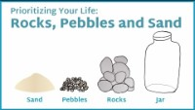
Prioritising you time… Rocks, Pebbles and Sand
This is a simple animation about the impact of focusing on the important things in life...or how if you focus on the trivial things, you’ll end up missing out on the important things. This metaphor is applicable to one’s personal life as well as one’s work life.
Rocks, Pebbles and Sand: Prioritizing Your Life - YouTube

Slide 19
Conclusion…
The difference between a good (or strong leader) versus a bad (or weak leader) is often subtle. It's all in your mindset and your ability to take ownership of problems and opportunities in a positive way.
In all the sample situations discussed above, you can see how people, whether employees or volunteers, can be met with either resistance or gratitude.
The good leader sees the glass half full and becomes the person everyone wants to help. Meanwhile, the bad leader is stressed out and can't figure out why everything is always so frustrating and struggles to keep up (with the team and tasks).
It's easy to read this and say, "I'll be the good leader, of course." However, it's harder in the moment.
You need to have a growth mindset, manage external pressure, and fight any imposter syndrome that has crept into your psyche.
No one is a natural at all of this, so stay positive even when you slip. Teams respect leaders that admit when they're wrong and put in the work to make things right. The payoff is well worth your investment: loyalty, hard work, and seeing the best work from your team and organisation.

Slide 20

Understanding the key players: Leaders, Managers, Mentors & Followers
2

Slide 21

Key Players…
Leadership does not occur in isolation. Leaders influence change by helping group members to accomplish their objectives. This section will provide you with a deeper understanding of the behaviours associated with the following terms: leadership, management, mentorship, and followership.
The development of emotional and social intelligence will also be discussed as an integral aspect of effective leadership.

Slide 22
Key Players
1
Leaders
3
Mentors
Managers
2
4
Followers

Slide 23
1. Managers:
Generally, management consists of 7 elements as defined by the acronym POSDCORB.
Planning refers to the action of determining goals for the future.
Organising requires the manager to design an efficient and effective workplace.
Staffing refers to the manager’s duty to recruit, hire, train and maintain staff
Directing or guiding the organisation to meet specific objectives
Coordinating or synchronizing the activities and use of resources.
Reporting or communicating progress and results
Budgeting using scarce resources wisely.
Although critics consider POSDCORB to be an overly simplistic view of management, each of the seven elements continues to be evident within management practices.

Slide 24
2. Leaders:
The responsibilities of managers and leaders within a group or organisation are closely linked. Leadership is regarded by many as the ability to guide others into actions that meet the needs of the organization or as “the process of engaging and influencing others”.
Third sector leaders identify the needs of clients/ the community, establish what is required to improve their situations, and then encourage others to engage in actions that meet these needs.
Leaders are recognised for providing visions and strategies, while managers are responsible for operationalising those visions and strategies.
Leadership by individuals is evident throughout the third sector. Not all leaders are appointed to formal positions of leadership. For example, community leaders have the knowledge and skillsets required to assist individuals in leading improved lives and to support organisations in building quality visions, systems, or strategies.
Leaders communicate their vision for the future to others through a combination of words and actions. These leaders create and follow a vision for the future.
Action is much louder than words alone. Leaders make a difference.

Slide 25
3. Followers:
Followership is frequently described as the “upward influence” of individuals on their leaders and their teams. The actions of followers have an important influence on staff performance and organization strategies and outcomes.
Being an effective follower requires individuals to contribute to the team not only by doing as they are told but also by being aware and raising relevant concerns. Effective followers realise that they can initiate change and disagree or challenge their leaders if they feel their organisation or unit is failing to promote positive change as set out in the organisation’s aims and objectives.
Leaders who gain the trust and dedication of followers are more effective in their leadership role. Everybody has a voice and a responsibility to take ownership of the workplace culture, and good followership contributes to the establishment of high-functioning and high-impact-conscious teams.

Slide 26
4. Mentors:
Experienced and thoughtful mentors play an important role in the development of third sector leaders. Mentorship is a reciprocal relationship between an expert and a novice; the expert provides advice, feedback, and guidance, and the novice assists the mentor with projects while maintaining a relationship of respect, loyalty, and confidentiality. Without mentorships especially for females working in the third sector, we would have a serious shortage of leaders. Many roles are voluntary, and mentorship often becomes an organisation’s training system, but it also acts as a source of inspiration and motivation.
Mentors can provide emotional support and career guidance that advance new female leaders and managers to professional success with confidence.

Slide 27

Being fluid…
Adapting the individual third sector leadership style to meet the needs of the organisational environment is critical for leadership success.

Slide 28

Self-analysis: Questions to ask yourself to identify your Strengths
3

Slide 29
Why do we need to Identify our Strengths?
The truth is that everyone will experience varying degrees of success and failure during their life. It’s an inescapable fact. No one who ever made it somewhere in terms of accomplishments did so by following a straight path to the top. For most, it’s a zig-zag of giving and taking, where one might take 2 steps forward followed by 4 steps back.
So, then the question becomes this: If I am surely going to fail and succeed at different points of my life, how can I work to reduce risk and increase the likelihood that I spend more time succeeding and less time failing?
All of this has to do with identifying and leveraging your personal strengths.

Slide 30

Identifying your own STRENGTHS…
Many people struggle to identify their strengths. The same often holds true for those in leadership positions. According to a recent Gallup report, it’s close to impossible to be an effective leader unless you’re aware of your strengths.
If you want to live up to your full leadership potential, you must first identify your talents – let’s take a look at how to determine what YOU do best, and then in the next section we will discuss how you can use that information.

Slide 31
SELF-DISCOVERY
MAINTAIN A HOLD ON YOUR IDENTITY
FIND CLUES IN PREVIOUS ATTEMPTS/ FAILURES
ASK A FRIEND
KNOW YOURSELF
ANALYSE YOUR SUCCESSES
Some Tips on how to Identify Your Personal Strengths
USE A STRENGTH TEST
Exercise some self-awareness & start evaluating yourself
Others often know you better than you know yourself. So ask!
There are lessons to be learned in all attempts and failures
Learn from what you did right so that you can recreate it.
Know who you are and what you stand for…don’t be swayed
Use a test that is designed to help you identify strengths unbiasedly

Slide 32

Identifying your Strengths
Certain strengths may be easy for you to recognise. For example, if you’re frequently asked to speak at conferences, public speaking may be one of your assets. Pinpointing other things you do well may take more self-evaluation.
Let’s take a look at a few questions you can ask yourself that provide insight into potential strengths and your overall leadership style.

Slide 33

Strategic / Analytical Leader
Do you think and plan before you act? If you prefer to consider multiple options before acting, you may be someone who has a talent for analysing situations.
Can you take complicated goals and make them clear for your team? This is a sign of a leader who is both a strategic thinker and a good communicator. Your team knows what is expected of them and what steps they need to take.
Can you recognise a situation that calls for change? If yes, you likely have a strong ability for analytical thinking. You can visualise what needs to happen to reach a desired outcome.
Do you look for ways to improve new ideas rather than discourage them? If so, you have the ability to see both the flaws and the potential in an idea, which can be both a strategic and analytical skill.

Slide 34

Relationship-Based Leader
Do you provide others with direction and purpose? This is typical of a leader with good communication and team-building skills.
Do you bring out enthusiasm and engagement in your team? If you answered yes, this demonstrates that you are able to connect with other people to draw the desired outcome.
Do your employees/volunteers trust you? If your team feels comfortable approaching you with ideas and concerns, this may indicate that you excel at building relationships.
Do you coach and mentor employees/volunteers? If you are frequently sought after to provide coaching and mentoring, it indicates you have strong interpersonal skills.

Slide 35

Results-Driven Leader
Do you follow through on objectives until the project is completed? If your answer is yes, this indicates a results-driven personality. Others likely recognise that you can be counted on to deliver as promised.
Do many people seek your opinions? If colleagues and friends frequently ask you to weigh in, it may indicate that you are respected for your technical and professional expertise. That is often a quality in a results-centric leader.
Do you go above and beyond what needs to be done? If you regularly accomplish more than the bare minimum, you likely have a strong sense of initiative that helps you meet goals quickly.

Slide 36
SELF ASSESSMENT ACTIVITY
Take a sheet of paper and start writing…
Can you LIST 5 of your strengths?
What do these strengths tell you about your LEADERSHIP STYLE?
What can or have you learned from previous task attempts or failures?

Slide 37
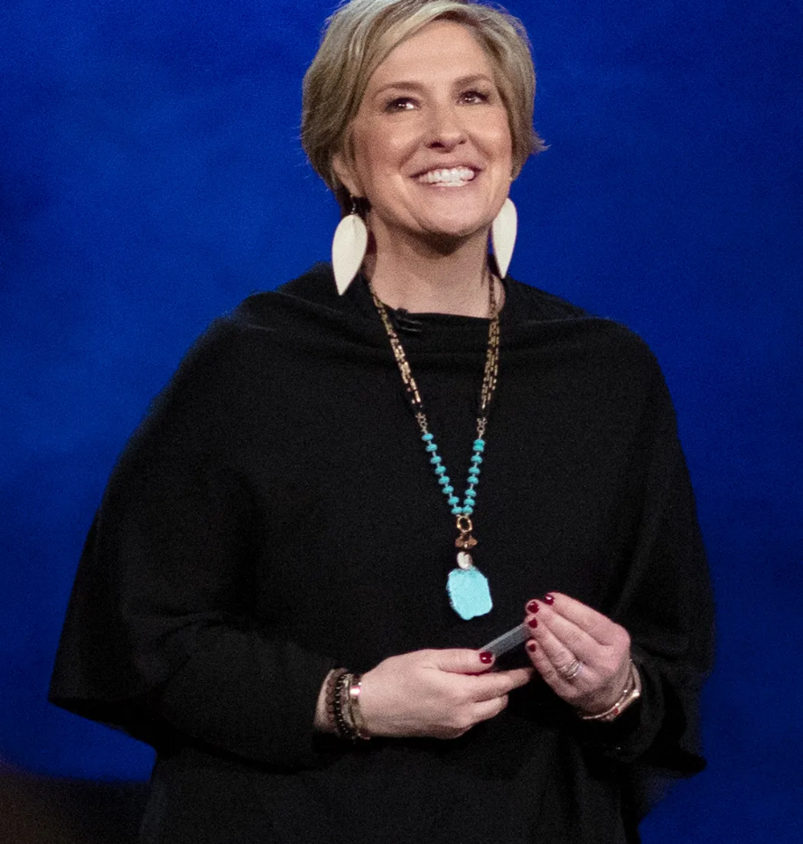
Daring Leadership Assessment by
Brené Brown
Daring leadership is a collection of four skill sets that are teachable, observable, and measurable: Rumbling with Vulnerability, Living into our Values, Braving Trust, and Learning to Rise.
The Daring Leadership Assessment will help you gauge your strengths and your opportunities for growth as a daring leader.
https://daretolead.brenebrown.com/assessment/

Slide 38

How to USE your Strengths
4

Slide 39
Using your Strengths…
Now that you have a sense of what you do best, it’s time to figure out how to leverage your skills. Let’s look at three leadership styles based on your core strengths and how to manage most effectively depending on your style:
Strategic / analytical leader: If you have strategic and analytical strengths, you should not feel pressured to make snap decisions. Your strength lies in your ability to step back and see the big picture. You function best when you give yourself time to absorb all the facts first, and then offer your insight and provide direction to your team.
Relationship-based leader: If you have a talent for building relationships and communicating, you probably excel at motivating a team. Use these skills to encourage your direct reports to share ideas and collaborate. A leader who is skilled at relationship building will likely inspire loyalty and engagement, resulting in employees who do their best work.
Results-driven leader: These leaders are the ones everyone relies on to do the heavy lifting. That’s because you’re recognised as someone who can meet goals and achieve results. People want to work for you, and other companies or organisations want to do business with you.
Recognising what you do best and leveraging those strengths is key to good leadership

Slide 40
Case studies showing examples of Women using their strengths in the Third Sector…

Slide 41
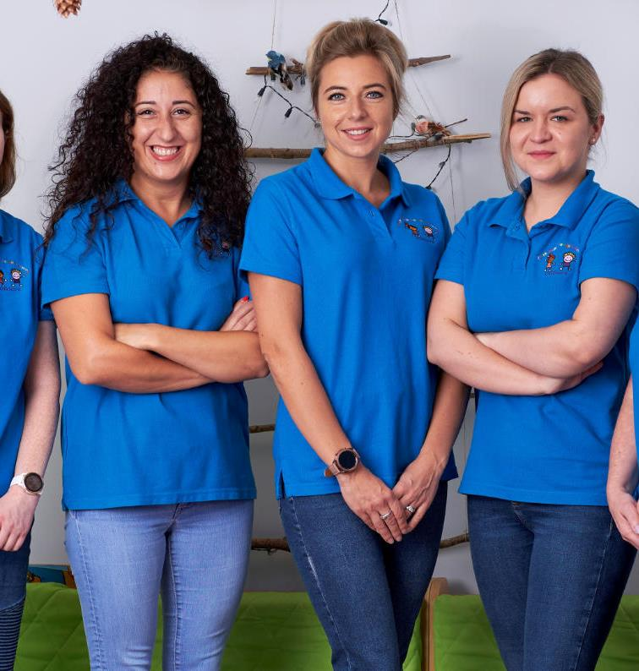
Breaking Barriers to Discover Strengths
First Steps Women’s Centre, Dungannon
First Steps Women’s Centre is a third sector organisation that provides training and support to women within Mid Ulster in Northern Ireland.
When women come to the Centre, they often lack confidence in their own abilities and FSWC is often their first step back to a learning environment and providing a few hours of ‘me time’ where they can concentrate on themselves rather than focusing on their other commitments.
This is the first step in supporting women to identify their own strengths as leaders. FSWC have successfully provided solutions to the challenges often met by women and offer a ‘safe space’ for learning and development.

Slide 42
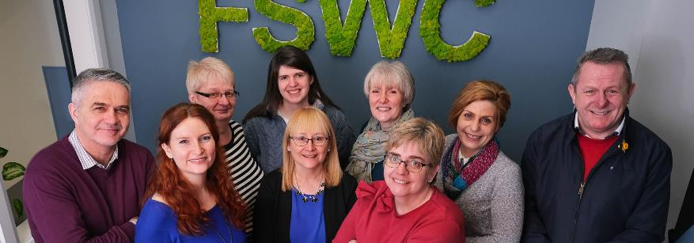
Breaking Barriers to Discover Strengths
Quite often potential female leaders are unable to access training due to lack of childcare options and transport issues, particularly those in rural areas.
FSWC put in place a childcare facility within their centre for women to help them take their first step in identifying their own strengths through their courses.
They also broke the stigma of transport issues and provide women with transport to the courses they are running.
FSWC breaks barriers to women developing leadership skills and enables them to progress in their roles.
“Women learning and developing together in a ‘safe space’ where barriers, including childcare and transport, have been removed, provides them with opportunities to discover themselves and their known and often times, unknown abilities and strengths. They develop the confidence to grow and to realise they can lead in their communities.”
Joanne Orr, HR, FSWC.
SOURCE: First Steps Women’s Centre, Dungannon

Slide 43
How it was done…
FSWC provided a safe space’ for women learning and developing together where challenges, including childcare and transport, have been removed.
They provide women with opportunities to discover themselves and their known and unknown abilities and leadership strengths.
In this environment, women develop the confidence to grow and to realise they can lead in their communities.
Participants have gone on to lead in their communities, progressed to further and higher education, gained employment and have become trainers and returned to the Centre to deliver courses to other women.
This ‘pay it forward’ experience and learning from someone who was once sitting in the chair they are in now, gives women the opportunity to see that they too can make a difference within their communities, regardless of their starting position.
FSWC’s workforce supports and promotes its women leaders, with 89% of the workforce female and 75% of the Senior Management Team being women.

Slide 44
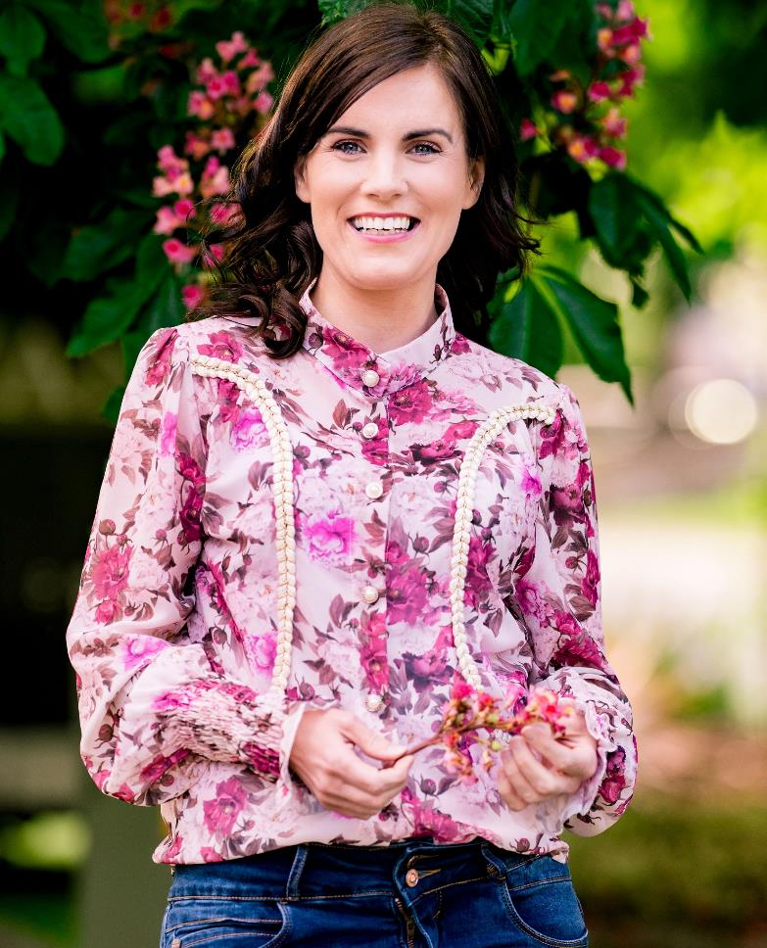
Case Study 2: Claire O’Hanlon MBE
Claire O’Hanlon’s role as a leader in the voluntary sector has enabled her to create positive social change for people living with muscle wasting conditions in Northern Ireland.
She created her own awareness and fundraising initiative – Leap for Luke – to support people like her son – she has raised over £100,000 to date!
She holds a senior leadership role as a Trustee of Muscular Dystrophy UK and campaigns for improved care services for people living with muscle wasting conditions in Northern Ireland.
She is a patient advocate in the field of rare disease drug development.
Using your leadership strengths to Make a Difference!
SOURCE: Claire O’Hanlon/Leap for Luke

Slide 45
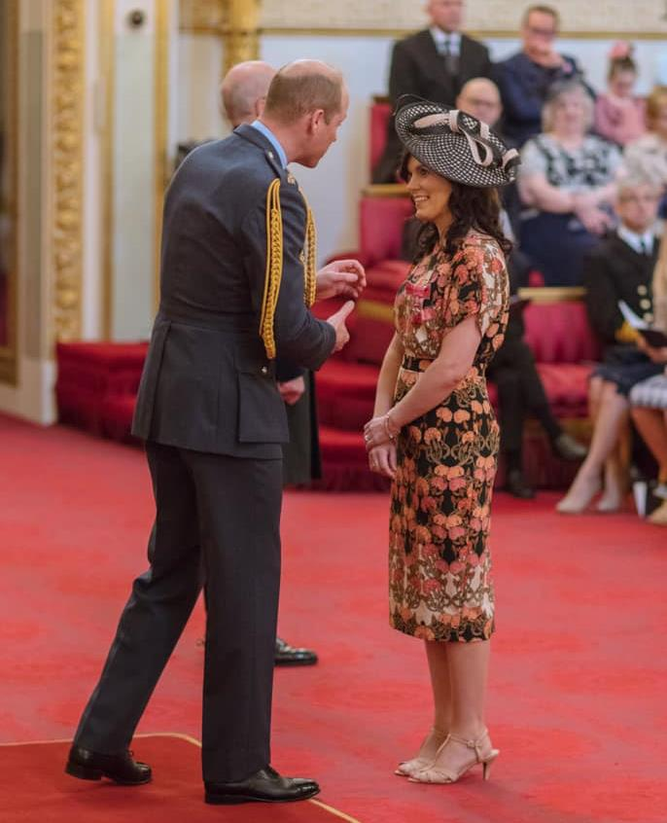
How it was done
COMMUNICATE
Claire is able to help people to see that they can make a difference in the world and this in turn inspires them to take action.
Claire explains the ‘what’ and the ‘why’ to create a sense of urgency for change.
By helping others to understand why the goal is important, and the role they play in achieving the goal, it becomes much easier to influence people to help create the change.

Slide 46
How it was done
COLLABORATE
Be others-centered – Claire is a Peer Support Volunteer and provides emotional support to newly diagnosed families.
Claire brings people together to plan and execute the change that is critical.
COMMIT
Claire demonstrates resilience and persistence in the face of adversity. She is willing to step outside of her comfort zone. She has also devoted more of her own time to create change and is focused on the big picture.

Slide 47
“
My greatest strength as a leader is in being able to translate often complex issues into language that everyone can understand
Claire O’Hanlon MBE
”

Slide 48
Exercises and Activities

Slide 49

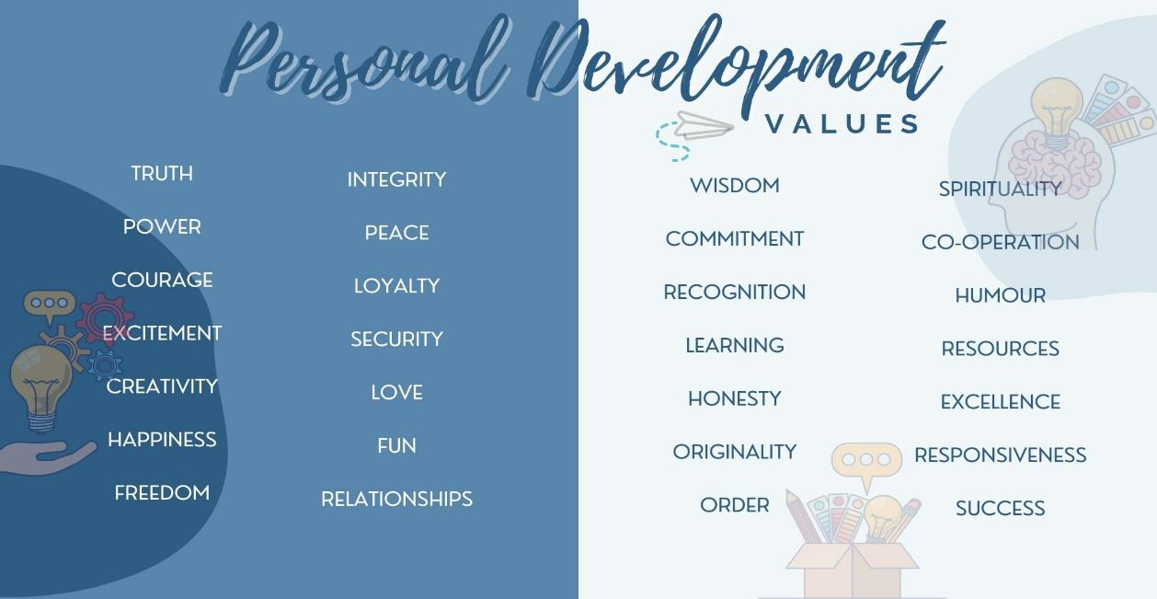
EXERCISE: Identify your Core Values
To truly identify your leadership strengths you must first identify your core values.
Step 1: Read through every value on this list of 28 core values

Slide 50

EXERCISE: Identify your Core Values
Step 2:
Select 8 values which resonate with you the most.
Do not over-think this process but do take your time.
If you have a value word that is not in the list, please write it down. There is power and meaning in your own words.
TIP: Select values that you currently hold. You do not need to rank these values in order.
My 8 Values:

Slide 51
EXERCISE: Identify your Core Values
Step 3:
Remove 4 to have your 4 core values remaining.
This can be a difficult task! Remember, this doesn’t mean that those eliminate are no longer important to you. It simply means they are not in your top 4.
These values will become the cornerstones of your leadership journey. You are now more aware of what truly matters to you as a leader!
My 4 Core Values:

Slide 52
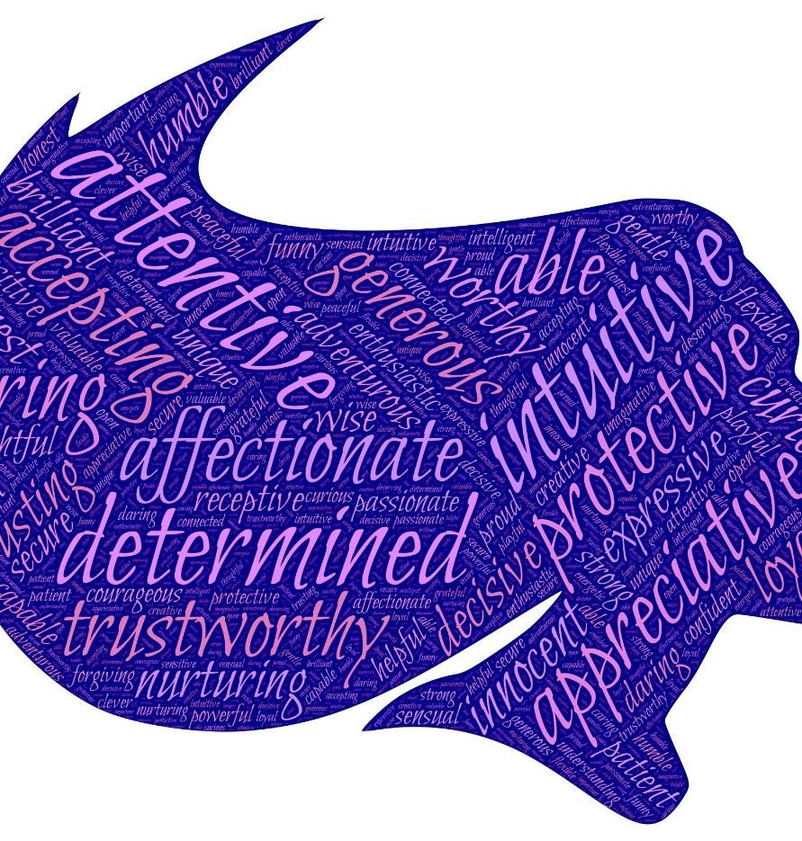
CTR + Click on the image on the right to discover your strengths and your opportunities for growth as a daring leader.
Do &
learn
The Daring Leadership assessment from Brené Brown is an assessment of four skill sets that are 100% teachable. Use this activity to explore your vulnerability, self-awareness and courage!
https://daretolead.brenebrown.com/assessment/

Slide 53
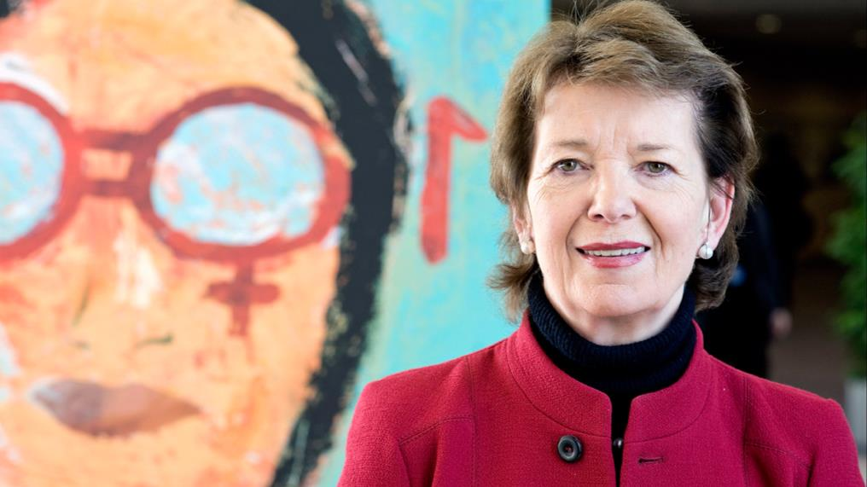
CASE STUDY: A President with a Purpose
Shining a light on leadership strengths

Slide 54
Identifying Leadership Strengths
MARY ROBINSON

Slide 55
A President with a Purpose
Who is Mary Robinson?
Born Mary Bourke in May 21, 1944, Ballina, County Mayo, Ireland, she is widely regarded as a transformative figure for Ireland, and for the Irish presidency.
Irish lawyer, politician, and diplomat who served as president of Ireland (1990–97), the first woman to hold that post.
She later was United Nations High Commissioner for Human Rights (UNHCHR; 1997–2002).
She is also a founding member of the Council of Women World Leaders.
Throughout her career, Mary Robinson has occupied many prominent roles and has worked on issues as varied as climate change, women’s rights and poverty alleviation.
Implicit in her efforts to better humanity is a belief in the idea that the world can be better, and a sense of what she can do to make it that way.

Slide 56
A President with a Purpose
Charisma and commitment are some of the many leadership strengths of Mary Robinson. Driven by issues and a burning sense of injustice she was led to run for the presidency.
As a charismatic leader, in her time as President, Robinson revitalised the office of the President.
Her strong commitment to human rights was evident in many of her actions:
She was the first head of state to visit Somalia after it suffered from civil war and famine in 1992
the first to visit Rwanda after the genocide in that country in 1994
the first UNHCHR to visit China
She did not compromise in order to maintain her popularity — she became the first Irish president to meet Queen Elizabeth II and the first to shake hands with Gerry Adams in Belfast in 1993, creating huge controversy and condemnation for herself.

Slide 57
A President with a Purpose
“You have a voice, I will make it heard.”
One of her strongest leadership qualities is reflected in her presidential campaign slogan - her ability to listen. People felt a connection to this woman who listened to their needs.
Mary Robinson’s leadership relied on her ability to energise and reflect the mood of the Irish people.
She believed in the power of ‘story’ as an effective tool to raise social consciousness.
Throughout her long career there is a steadfast commitment evident in her actions and endeavours: her commitment to improving the human condition through human rights.
Mary Robinson inspires us to:
Listen at all times
Follow your individual path of leadership
Be guided by your own inner moral compass
Be committed
Align your vision with your values
Have integrity and determination

Slide 58
„
I must be a President for all the people, but more than that, I want to be a President for all the people. Because I was elected by men and women of all parties and none…and above all by the women of Ireland, mná na hÉireann, who instead of rocking the cradle, rocked the system and who came out massively to make their mark on the ballot paper and on a new Ireland (Mary Robinson, victory speech).
„

Slide 59
NEXT:
Module 3
Feminist leadership and female gender qualities for leadership
THANK YOU for finishing Module 2 of the Shine Open Education Resources.
We are confident you are on your path to securing a visible role in the third sector leadership. CONGRATULATIONS!
www.shineproject.eu

