Slide 1
The World Needs Women to Take the Lead
Module 3
This project has been funded with support from the European Commission. This publication [communication] reflects the views only of the author, and the Commission cannot be held responsible for any use, which may be made of the information contained therein.

Slide 2
WELCOME TO SHINE
The SHINE project www.shineproject.eu upskills women with the knowledge and behaviours necessary to confidently and successfully transition into leadership roles in their third sector /community workplace.
The SHINE Strengthening Female Community Leaders Open Education Resources have been carefully designed to be used by VET organisations across Europe and delivered to the women in the third sector.

Slide 3
01
Gender stereotypes and leadership
CONTENTS OF MODULE 3
02
Feminist ethics
In Module 3, all the traits of female leadership become evident, as well as why the world needs this shift in the leadership, as well as the communities, do. We purposely focus on positive and inspirational learning regarding female leadership. Addressing challenges and barriers will be done later, after setting a positive tone.
03
Peaceful leadership
Female voice in storytelling – effect on leadership
04
05
Working with others
06
Implementing fairness, justice, equity, inclusion
07
Why the world needs women to take the lead?

Slide 4
Gender stereotypes and leadership
01

Slide 5
SHINE and female gender
The SHINE project aims to upskill women with the knowledge and behaviours necessary to confidently and successfully transition into leadership roles in their third sector or community workplace.
Throughout history, women have too often been deprived of equal opportunities for leadership.
We hope that the SHINE focus on female leaders will help overcome the obstacles that stereotypes have created towards their role in leadership.

Slide 6
The FourCe‐PITO conceptual framework of leadership is designed to help guide leadership development and education.
It is important to understand variables relevant to effective leadership.
Gender is one such variable that must be examined with regard to optimizing leadership effectiveness.
Callahan and Grunberg identified four leadership domains to capture key elements of leadership models, Character, Competence, Context, and Communication.
These four C's (“FourCe”) occur across four different psychological levels—Personal, Interpersonal, Team, and Organizational (PITO). The PITO levels were adapted from the leadership training model developed at the United States Air Force Academy.
Let’s examine in more detail…….
SOURCE: Gender and Leadership, Kathryn E. Eklund, Erin S. Barry and Neil E. Grunberg - https://www.intechopen.com/chapters/52503

Slide 7
The FourCe‐PITO
Gender and Leadership
Kathryn E. Eklund, Erin S. Barry and Neil E. Grunberg
Personal refers to aspects of self as well as perception of self and self‐awareness.
Interpersonal refers to how one's perception of self and personal characteristics, as well as perception by others, affects each dyadic relationship.
Team refers to small groups of people interacting for a common purpose.
Organizational refers to large groups of people and systems that affect people.
Character includes all characteristics of the individual—physical (e.g., sex, race, age, appearance) and psychological (e.g., gender, personality, values, outlooks, attributes).
Competence includes transcendent leadership skills (e.g., high emotional intelligence, critical and strategic thinking, leading by example, motivating and empowering others) and specific expertise determined by role and specialty.
Context includes physical, psychological, cultural and social environments, and various situations (e.g., stress).
Communication refers to verbal (oral and written) and nonverbal, sending and receiving of information.

Slide 8
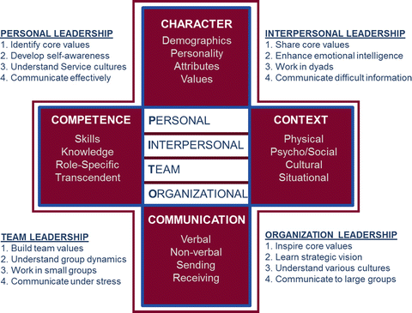
The FourCe‐PITO in action:
!
Gender and Leadership, Kathryn E. Eklund, Erin S. Barry and Neil E. Grunberg https://www.intechopen.com/chapters/52503,
https://link.springer.com/chapter/10.1007/978-3-319-64740-1_13

Slide 9
What this means:
Understanding how gender may influence internal and external leadership processes is important to reach equality for those gender groups who have traditionally been stereotyped, and discriminated, against and to boost the leadership outcomes for women who have traditionally been experiencing barriers

Slide 10
Let’s explore gender bias
Through classic tales with a twist
Karrie Fransman and Jonathan Plackett explore gender bias in classic fairy tales with a twist: https://www.theguardian.com/books/2020/oct/28/gender-swapped-fairy-tales-review-handsome-and-the-beast-and-the-ugly-brothers

Slide 11
THOUGHT PROVOKING….
Stereotypes Facing Women in Leadership Today
Back in 2011, ForbesWoman published an article on the ten worst stereotypes facing women in the workplace today. These stereotypes reflect how dangerous biases regarding women’s success can be and how they are still a part of the collective subconscious a decade later.
READ THE ARTICLE THAT SUMMARISES THESE STEREOTYPES HERE: https://sites.psu.edu/global/2021/02/15/stereotypes-facing-women-in-leadership-today/
How does this article on stereotypes make you feel?

Slide 12
Feminist ethics
02

Slide 13
Feminist Ethics
Feminist ethics is a philosophy that aims to eliminate the oppression of women. At times, it can include oppressed minority groups.
The goal of feminist ethics is to create a plan that will hopefully end the social and political oppression of women.
The Ethics of Care is an important part of this perspective, although it is important to distinguish that Ethics of Care does not equal Feminist Ethics. It’s important to be careful and free of any stereotypes. Let us show you how to differentiate between Feminist Ethics and Care Ethics

Slide 14
Differentiating Feminist Ethics and Care Ethics
Care ethics and feminist ethics are different, though at times they correspond to each other.
Some feminists do not believe it is appropriate to characterize the ethics of care as specifically feminist.
Navigating through differentiating what makes up the feminist ethics in leadership, without stereotyping is the challenge imposed by years of societal wrong treatment of women.
In this task, we must find a way to celebrate what makes women good leaders but be careful not to fall into the trap of limiting and further stereotyping.

Slide 15
Learn more about Feminist Ethics and how care applies from Shanti Chu, watch the video

Slide 16
A Different Leader? Prime Minister Jacinda Ardern
Leadership ethics based on feminised ideals such as care and empathy
But be careful about the „Othering”
Jacinda Ardern is lauded as exemplifying caring and compassionate leadership. She was elected as Prime Minister of New Zealand in 2017.
Despite challenges to her political interventions, PM Ardern received considerable positive news coverage for her compassionate and heartfelt approach to leadership following the Christchurch shootings in New Zealand in 2019 where 51 people died.
Heralded for feeling deeply (Roy 2019) and acting with sympathy, love and integrity (Moore 2019), Ardern’s vision for a better world gained global attention at a time when world leaders were facing scrutiny and criticism.
Despite her exemplarity, the established stereotypes of women and women leaders are not irrelevant to Arden’s political position.
When Ardern falls short of public expectations in her decision-making and actions, as a woman leader she is often criticised because she fails to enact a version of femininity expected of her.
Her female body is caught up in gendered expectations from the global public because she offers an alternative model of leadership such that Ardern's feminine leadership (caring and compassionate) is employed as a strategy which differentiates her from masculine leadership and ethics (Krewel and Karim 2019). Her leadership is judged in relation to her female body, especially motherhood (The Guardian 2019).
In this way, Ardern is othered (see next slide)
SOURCE: https://link.springer.com/article/10.1007/s10551-020-04526-0

Slide 17
A Different Leader? Prime Minister Jacinda Ardern
Read the full article by Pullen, A., Vachhani, S.J. Feminist Ethics and Women Leaders: From Difference to Intercorporeality. J Bus Ethics 173, 233–243 (2021). https://doi.org/10.1007/s10551-020-04526-0
What Is Othering? Othering is a phenomenon in which some individuals or groups are defined and labeled as not fitting in within the norms of a social group. Read more about it here: https://www.verywellmind.com/what-is-othering-5084425
IMAGE SOURCE: Governor-General New Zealand

Slide 18
Want to explore more about feminism, feminist ethics?
Watch the trailer
Feminists: What Were They Thinking? is a 2018 documentary film directed by Johanna Demetrakas and starring Laurie Anderson, Phyllis Chesler and Judy Chicago among others.
Women of different ages and backgrounds are interviewed by Demetrakas and a team of assistants on the subject of feminism, anchored in the book 'Emergence' with portraits by the photographer Cynthia MacAdams published in 1977.
The film was partly funded by the International Documentary Association and also by a crowd funding campaign. It was released by Netflix on October 12, 2018.

Slide 19
In your role as a community leader, there are ways we can lift each other up.
Make sure women’s ideas are heard
Challenge the Likeability Penalty. The Likeability Penalty often surfaces in the way women are described, both in passing and in performance reviews. When a woman speaks in a direct style or pushes her ideas, she is often called “aggressive” and “ambitious.” When a man does the same, he is seen as “confident” and “strong.”
Celebrate women’s accomplishments
Encourage women to go for it
Give women direct feedback
Mentor and sponsor other women
SOURCE: https://leanin.org/tips/workplace-ally

Slide 20
CRITICAL THINKING ACTIVITY
Read this article: Ways Women Lead by Judy B. Rosener, Harward Business Review
Try to answer these questions!
What do YOU think about this article?
What do you agree with?
What do you not agree with?

Slide 21
Peaceful leadership
03

Slide 22
Peace leadership is a desire for inclusion and cohesion whereby individuals are enabled to live in liberty to their fullest potential, free from the oppression of powers who seek to wield dominance.
Third-sector leaders implement Peace Leadership in their communities, to reach their social missions

Slide 23
PEACE LEADERSHIP MODEL
Just
and
caring global community
MUTUALITY
COMPASSION
Attitudes, behaviours
and thoughts that support a more humanistic world
Relational mastery
ECONOMIC
SOCIAL
Relational awareness
Self-mastery
HUMANITY
RECIPROCITY
Self-awareness
INTER-CONNECTEDNESS
ENVIRONMENT
DIGNITY

Slide 24
Peace Leadership
The focus on peace leadership is both individual and communal such that we need to practice inner peace so that we can practice community or external peace from a place of personal peace.
The purpose of peace leadership is to work from a place of inner peace for the purpose of bringing about global peace by challenging existing violence and aggression and creating programs for both individuals and communities that focus on educational efforts for peace.
SOURCE: http://deeperleadershipinstitute.com/ann-dinans-peace-leadership/

Slide 25
Components of Peace Leadership
Inner Peace
Outer Peace
Mind
Spirit
Body
Leading Others
Leading Communities
Self Leadership

Slide 26
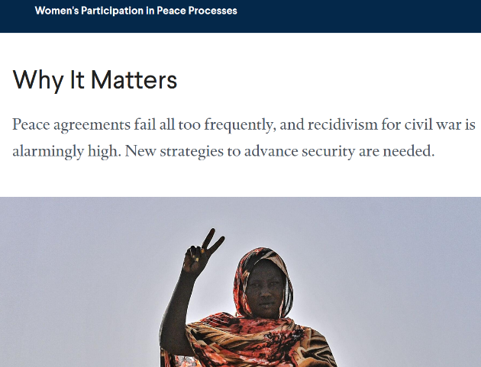
Women, peace and statistics
Women should not be expected to act in an especially peaceful way, so let us get that dangerous stereotype out of the way!
Let us also acknowledge, that research has shown that women are powerful peacemakers in important negotiations, especially in
managing conflict as leaders.
CTRL + CLICK ON THE IMAGE TO READ
Research examining all peace agreements in the post–Cold War period found the participation of civil society groups, including women’s organizations, made a peace agreement 64 percent less likely to fail.
Source: O’Reilly, Ó Súilleabháin, and Paffenholz; Nilsson; Paffenholz, Kew, and Wanis-St. John

Slide 27
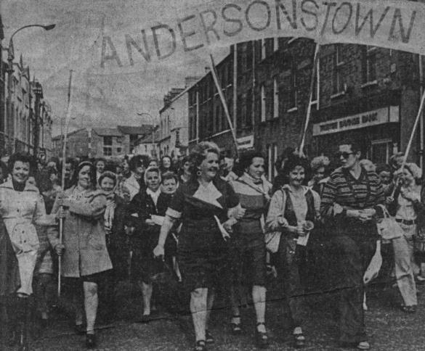
CASE STUDY: Northern Ireland Women’s involvement in the Peace Process
Twenty years ago, the landmark Good Friday Agreement ended 30 years of violence (known as the Troubles) between British Protestant unionists and the Irish Catholic nationalists. A critical factor that helped secure and preserve the peace is too often overlooked: the participation of women.

Slide 28
Northern Ireland Women’s involvement in the Peace Process
Civil society engagement and women’s leadership and participation are vital to building an inclusive and sustainable process, and a sustainable peace
This case study highlights the role women played, and continue to play, in the Northern Ireland Peace Process.
This case study links directly into the module in reviewing the strength of female community leadership in Northern Ireland
The formation of the NIWC led to the coalition’s participation on the negotiating team for the Belfast Agreement.
SOURCE: https://www.herstory.ie/photo-essays-2/2019/9/12/women-and-the-northern-ireland-peace-process
https://www.dfa.ie/media/missions/cyprus/newsandevents/Report-012019-The-Role-of-Civil-Society-and-Gender-in-Reconciliation.pdf

Slide 29
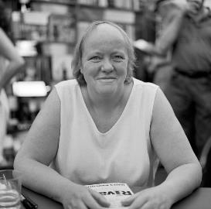
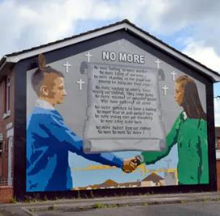
How it was done
‘Women Together’ set up by Ruth Agnew & Monica Patterson in 1970. As they were organising, so too were many local communities – Catholic & Protestant Women putting aside their issues and working together
‘This is not an organisation it is just a collection of mothers from the areas affected.’ – Betty Williams
Catholic and Protestant women’s groups led by Monica McWilliams and May Blood joined forces to establish the Northern Ireland Women’s Coalition in 1996.
NIWC awarded two seats on the Northern Ireland Forum for Political Dialogue - a body set up in 1996 as part of a process of negotiations that eventually led to the Good Friday Agreement in 1998.
Mo Mowlin, first woman Secretary of State for NI (1997) prioritised the finding of a solution to the troubles there. She attained an IRA ceasefire so they could join the all-party peace talks.
Mo Mowlin

Slide 30
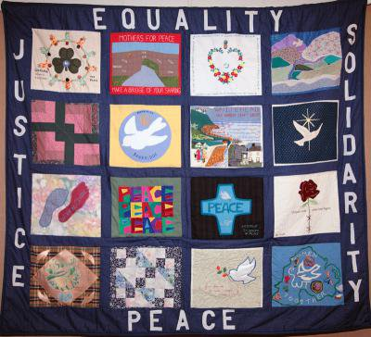
Civil society engagement and women’s leadership and participation are vital to building an inclusive and sustainable process, and a sustainable peace
Women Together Northern Ireland Peace Quilt
SOURCE: https://www.opendemocracy.net/en/5050/women-together-in-darkest-days-of-troubles/

Slide 31
Time for a story, inspiration from heritage and myths!
Sacred Olives: Athena's Tree on the Acropolis
Atop the Acropolis of Athens stands an olive tree that is a symbol of hundreds of years of dedication and reverence. Although this is not the ‘original’ tree honoured by pious Athenians over 2,500 years ago, it nonetheless stands in roughly the same spot as the original. The tree was an important foundation myth for Athens as it established the primacy of the goddess Athena within the city that would take her name.
IMAGE SOURCE:
https://www.flickr.com/photos/alex-david/

Slide 32
Sacred Olives: Athena's Tree on the Acropolis
Legend has it that Zeus offered a contest between Athena and Poseidon for the possession of Athens. Poseidon raised up his three-pronged trident, smashed it upon the hard rock of the Acropolis and out a salt spring sprang. Athena on the other hand produced an olive tree, its rich fruits bountifully dangling from the branches. This dramatic showdown between the two powerful Olympians was immortalized in stone, depicted on the West pediment sculptures of the Parthenon.

Slide 33
The olive tree symbolises peace, wisdom, prosperity, health, luck, victory, stability, and tranquility.
Let’s be inspired by these traits when contemplating leadership inspired by women.

Slide 34
Female voice in storytelling – effect on leadership
04

Slide 35
WHAT IS STORYTELLING?
The person makes an emotional connection with the story, and the message is considered genuine.
People are more inclined to engage, trust and follow the initiatives based on the connection they made through the story.
Storytelling is the process of making a connection with people, community, employees, public
Through skillful writing, however, a story is created that not only connects with the target audience; it helps you establish yourself as a trusted resource

Slide 36
This is where storytelling can help female leaders. Here’s how:
Remember stories of you are NOT about you, stories connect the dots, and your story can help someone else, inspire and supercharge your social mission. So, in telling a story about an achievement, reflect on the experiences that most people share.
Use three acts: explain the challenge, how you resolved it, and make the point for takeaway.
Seek feedback – it’s your time to listen.
WHAT KIND OF EFFECT DOES STORYTELLING HAVE ON LEADERSHIP?
Self-promotion is a delicate balance. But the alternative—hoping accomplishments speak for themselves and agonizing in silence until someone notices them—does nothing. As female leaders, we need to become fluent, comfortable and authentic in promoting our own achievements.
SOURCE: https://www.leadershipstorylab.com/2018-03-08-4-reasons-women-should-tell-more-stories-about-themselves-from-glass-hammer/

Slide 37
Interesting fact:
Women are interrupted significantly more often than men, according to more than four decades’ worth of research. In 1975, University of California sociologists Don Zimmerman and Candace West recorded 31 conversations in public places like coffee shops and drug stores. In the male-female conversations, the researchers noted 48 total interruptions. Men perpetrated all but two of them.
ARE FEMALE VOICES HEARD ENOUGH?
Let us pose the question to answer the question above:
Why, if women make up 55% of the European population, do they still only constitute less than 40% of speakers at policy debates at think tanks across Europe (source: Open society Foundation, 2019, and Ashoka Foundation, 2016-2019)?
SOURCE: https://leader.pubs.asha.org/doi/10.1044/leader.FTR1.24022019.44

Slide 38
„I know so many women who introduce themselves as though they are apologizing for something. When I’m one-on-one with them, they sparkle. They glow. But then a stranger asks them, “What do you do?” and it’s like the lights go out. No more glow. No more sparkle. They mumble their answer, throwing it away— apologizing, it seems, for taking up your time.
Why is this?”
Why Women Must Tell Their Stories
By Amanda Hirsch, click HERE to read

Slide 39
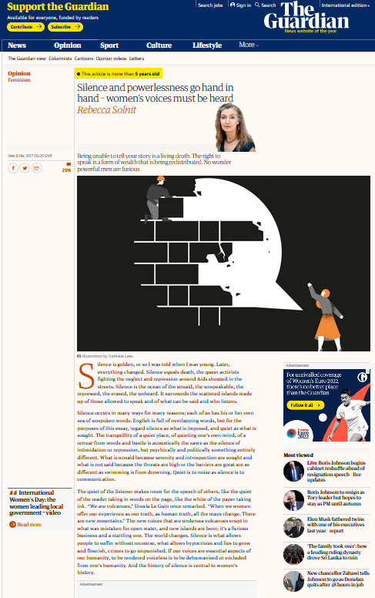
Silence and powerlessness go hand in hand – women’s voices must be heard
By Rebecca Solnit
„Words bring us together, and silence separates us, leaves us bereft of the help or solidarity or just communion that speech can solicit or elicit
.....
Stories save your life. And stories are your life.”
CTRL+CLICK on the image to read the full article

Slide 40
If you want to boost the participation of women in the activities you are organising, here is a helpful CHECKLIST
Has a diverse group of women been identified and invited?
Have you considered what assumptions you might be making when identifying groups to consult, based on traditional roles of women and men?
Has every possible effort been made to reach women who are disadvantaged or marginalised?
Have you considered how women may be affected by the plans in question?
Have you assessed how relevant budgets, policies, or programmes impact women?
Have the findings of this assessment been shared with those being consulted?
Have participants been informed about why a consultation is necessary?

Slide 41
If you want to boost the participation of women in the activities you are organising, here is a helpful CHECKLIST
Have participants been told about the potential for change by contributing their suggestions?
Have participants been told how they can access updates or feedback on their contributions?
Has there been more than one meeting scheduled and are they staggered over the week?
Has there been sufficient notice given for the meeting and have they been given a concrete end time?
Are there resources available to reimburse those attending meetings for alternative care arrangements and transport? Are participants aware of how to claim reimbursements?
Have you considered traveling to those you want to consult?

Slide 42
If you want to boost the participation of women in the activities you are organising, here is a helpful CHECKLIST
Can all information covered in the meeting be understood by everyone in attendance – is simple, straightforward language being used?
Is the group size appropriate for the members in attendance?
Has the moderator received gender and equality training?
Are there regular opportunities to ask questions or comment?
Are the barriers to attending meetings / engaging in discussion being recorded?
Are the outcomes of consultations being monitored?
Have you asked for feedback on the consultation process from participants?
Have changes been made regarding this feedback?

Slide 43
ONLY IF YOU ARE HUNGRY FOR MORE!
If you want to get a clearer picture of underrepresentation of femlae voices in media, take a look at this example on your right.
It is a study on women’s underrepresentation
in current affairs radio programming at peak listening times in Ireland.
CTRL+CLICK on the image to read the study

Slide 44
EXERCISE: Speaking in public (i)
Speak to the Chair of the meeting in advance to find out the rules of the meeting - who can speak, when, and for how long.
Write down what you want to say and practice
Find a supporter to be at the meeting
If you have to stand, stand with one knee on a chair - this will stop your knees from shaking so much
Look around and make sure everyone is included in your gaze
Pitch your voice lower than usual and speak slower than usual
(i) permission to use from changesuk

Slide 45
EXERCISE: Speaking in public continued
Try a stepped approach:
Step 1: Say something in the first 5 minutes of a meeting - even if it is to only agree with someone else. Just make sure you speak and say your name.
Step 2: Next time, speak early in the meeting and offer feedback - you can offer supportive feedback, which is less stressful.
Step 3: Next time, speak early in the meeting and offer an idea. Practice beforehand.
Step 4: Next time, speak early in the meeting and raise issues. Practice beforehand.

Slide 46
Watch the video storytelling piece and get inspired by the authenticity of the storyteller

Slide 47
Working with others
05

Slide 48
Working with others demands a set of skills. A good leader constantly evolves and looks at ways to improve collaboration. Female leadership sets values rooted in equality, and we recommend it to be based on openness, trust, and respect.
Here are several good starting points:
DISPERSED LEADERSHIP
PROBLEM SOLVING
LEARNING RESOURCES
Learn about Dispersed Leadership point of view in the next slides
Next, we bring you a fresh view on problem-solving
Let’s dive into some wonderful resources for long term non-formal learning

Slide 49
Dispersed leadership
A way of looking at leadership that is not necessarily focused on individual leaders in a hierarchical sense, is dispersed leadership. This is when people take on different leadership roles in groups and organisations so that leadership is expressed in different ways. People enact their leadership wherever they are in the organisation – volunteers, managers, administrators.
Instead of seeing ‘leadership’ as something invested in one person, we can consider leadership as a process.
Leadership can be seen as tackling the big issues that face a group or an organisation. There are three types of core issues which face a group or an organisation:
Strategic: the overall direction of the group and the vision
Task: how the group will achieve what it wants to
People: maintaining the morale, commitment and enthusiasm of people over time
Some groups will have more dispersed leadership than others, depending upon the culture of that group and membership activity.

Slide 50
Dispersed leadership
People demonstrate leadership in different ways:
Review where the group is going
Make sure people feel comfortable and welcomed
Search for funding opportunities
Represent the group in wider forums
Research matters of interest to the group or organisation
Know the local political and funding context
People can only be leaders if others in the group accept them as leaders, accept their influence–and this acceptance is often based on knowledge and expertise

Slide 51
Skills for dispersed leadership
Networking
Keeping in touch with people and events is a crucial activity for groups and organisations
Having a good network of contacts is likely to give a better class of information and lead to better decisions
Networks are about exchange and mutual support. Ideas, contacts, information are the sort of things that are exchanged
Ambassadorial roles, representative roles
Taking an ambassadorial role is an important leadership role as it is about managing external relationships and representing the group or organisation.
The ability to negotiate a fair position and protect the reputation of the group is a key leadership role.

Slide 52
Skills for dispersed leadership
Communication
Good communication skills are needed to influence decision making and influence people within and external to the group
Both written and verbal communication skills are required
Being a role model
Leading by example is a powerful leadership role; understanding how your own behaviour affects a situation and other people is key to self awareness
Maintaining morale and commitment
Creating an environment where people can share their thoughts and feelings is a step towards creating a positive group culture
Accepting responsibility for your own mistakes and celebrating successes are important leadership roles
Maintaining a sense of optimism and humour goes a long way to helping people feel committed members of the group

Slide 53
Problem-solving
- A different approach by Ken Smith
When used for problem-solving solving can help you identify the root cause(s) of a problem to implement creative and innovative solutions to improve efficiencies, reduce costs, streamline operations, etc. It’s what we get paid for, to bring value by solving other people’s problems. However, problem-solving can hurt you too if used incorrectly. Here is an illustration of how:
„If you think problem-solving is a critical leadership skill – you might have a problem! Wait, isn’t problem-solving a critical skill leaders must possess? The gurus and research say it is! Of course, it’s a critical skill! However, leaders sometimes use this skill wrong, and that’s the problem.”
Someone on your team brings a problem to discuss with you. 👉 Sometimes they bring problems and solutions. 👉 Sometimes they don’t. 👉 Sometimes they bring problems and dump them on you to solve. 👉 Sometimes they bring solutions that might not be the best.

Slide 54
Problem-solving
- A different approach by Ken Smith
What you do next is crucial!!! 🤔 Are you someone who wants to play the hero? 🤔 Are you someone that solves problems for them because it takes time to teach or coach? 🤔 Are you a people pleaser and want to solve everyone’s problem? 💥 Or do you employ one or a combination of the following methods:
„If you think problem-solving is a critical leadership skill – you might have a problem! Wait, isn’t problem-solving a critical skill leaders must possess? The gurus and research say it is! Of course, it’s a critical skill! However, leaders sometimes use this skill wrong, and that’s the problem.”
Teach – they lack the skill to problem solve; teach them how to problem solve.
Coach – they know how to problem solve; coach and guide them through the process.
3. Direct – they truly don’t have a solution or a good one; direct them through the process.
4. Intervene – there is a roadblock that prevents them from solving their problem; remove it. When you’re always solving their problems, no one learns, and it stunts everyone’s growth.
You become overwhelmed and stuck in the weeds. Your team becomes like Pavlov’s dog. They’re trained to bring you problems every time they’re faced with one. No one wins! Be better, help your team become great problem solvers so everyone wins! Problem solved!

Slide 55
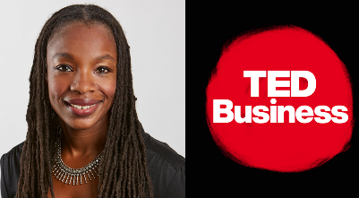
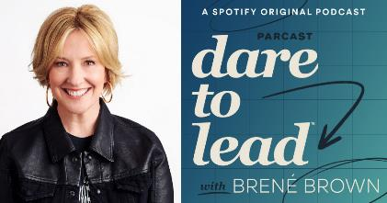
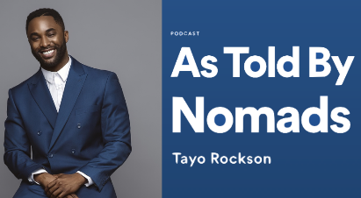
Get inspired to access fun and educational resources on a regular basis: The Three Great Leadership Podcasts to Listen to Right Now
One of the best leadership podcasts for anyone striving to overcome challenges in their position
Inviting some of the biggest changemakers – from presidents to doctors, this is a playbook for leaders of all levels
Interviews with global nomads, and entrepreneurs to discuss cultural complexities in business and communication
LISTEN HERE:
https://podcasts.apple.com/de/podcast/how-to-lead-in-a-crisis-with-amy-c-edmondson/id470622782?i=1000501558867
LISTEN HERE:
https://open.spotify.com/episode/002OXyawiR8K1imFEivJsm
LISTEN HERE:
https://play.acast.com/s/astoldbynomads/487-therealwaytocultivateleadershipwithdouggray
TED Business
Dare to Lead
As Told By Nomads

Slide 56
EXERCISE: women’s leadership and risk
Have a look at this model of leadership – it will ask you a series of questions about your willingness to dare:
https://daretolead.brenebrown.com/assessment/
Quote by Brene Brown: “Leadership is not about titles or the corner office. It’s about the willingness to step up, put yourself out there, and lean into courage. The world is desperate for braver leaders. It’s time for all of us to step up.”
Write down your first thoughts:
______________________________________________________________________________________________________________

Slide 57
06
Implementing fairness, justice, equity, inclusion

Slide 58
These key ATTRIBUTES OF FEMINIST LEADERSHIP developed from the practice will lead you through implementing fair and inclusive leadership, motivated by values such as justice and equity:
Shared leadership: Attention to bringing the collectivity/community along. Affirmation of emergent leadership qualities inherent in all (“training more about affirming skills than imparting skills” – Susan Eaton). Mentoring is key.
Relational: Building strong trusting relationships, while minding the cultural specificities. There is the importance of storytelling in affirmation of the person and the community.
Inspirational/Spiritual: Oriented to the protection and nourishment of the human spirit in everyone wherein the capacity for leadership resides – thus increasing the capacity to transform the individual, their relationships, organizations, and communities
SOURCE: We Rise, Feminist Leadership: Key Definitions

Slide 59
These key ATTRIBUTES OF FEMINIST LEADERSHIP developed from the practice will lead you through implementing fair and inclusive leadership, motivated by values such as justice and equity:
Clarity of purpose: With an orientation toward the transformational (of the individual and the whole).
Explicit awareness and attention to power dynamics and their varied meanings in context of different cultures and identities. Critical attention to the role of fear and the need for control in the power relations of dominance. Sympathetic recognition of fear in the individual and the community. A lot of leadership is about bringing people through their fears toward collective goals.
Attention to learning to practice of ritual, celebration, and the personal and community expressions of joy and sadness. Joyful expression is highly valued.
Creating safe environments for expression, self-care, participation, and growth of leadership skills. Collective support for challenging each person to the best practice of leadership
SOURCE: We Rise, Feminist Leadership: Key Definitions

Slide 60
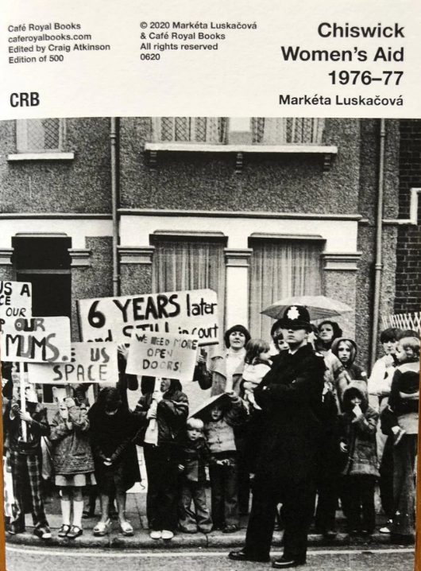
CASE STUDY: Feminist Collective Leadership and Action
Listen to Sue Gorbing talk about the origins of the Birmingham Women’s Aid, UK, click on the speaker icon to listen
Violence against women was not recignised as an issue; rape within marriage was legal.
Women organised to challenge this situation and provide support to women

Slide 61
Women, together, have to take the power in their own hands in order to make change happen
Feminist collective leadership and action
This case study illustrates the value of shared passion, collective leadership, and determination and how they can challenge and change society’s values.
Feminist leadership is based on the values of social justice and equality; it is about transformation - personally, culturally, and structurally.
This was a collective leadership response to the dangers facing women from male violence and is an excellent example of feminist leadership and activism.

Slide 62
How it was done
Women were angry at the casual acceptance of male violence against women, the victimisation and blaming of women and the lack of support for women
A group of women got together to decide what they could do for themselves
They tried approaching the local government with little success
They took over an empty building and created a refuge for women who experienced male violence and challenged local policymakers: they took risks
They devised a specialist self-defense course for women and trained women to train others
They organised themselves on a non-hierarchical basis - working to share power, decision making, leadership and tasks
They explored the differences between them, learnt from them, and valued their own experiences
It took a long time and determination
They became part of a nationwide movement that campaigned to support women, change attitudes and the law, and which still exists today

Slide 63
Community Leadership
Community leadership means having responsibility for the well-being and improvement of the community
Are you a community leader? Are you interested in becoming one?
3rd SECTOR LEADER INSPIRATION
“When the whole world is silent, even one voice becomes powerful.” - Malala Yousafzai

Slide 64
Understanding empathy
Empathy is the ability to understand and share another person’s feelings and emotions. It is essential to building good relationships.
The research shows that empathy is partly innate and partly learned.

Slide 65
EXERCISE
Describe your community / the beneficiaries of your mission to detail
Who is your community comprised of, what groups?
What are their demographics, their behaviour?
Is it a geographical or virtual community?
What are the problems, and weaknesses of your community, what are its strengths?

Slide 66
What is a strong, positive and equitable community?
Sense of Community Has 4 Factors
Membership – the feeling of belonging
Influence – a sense of mattering. Working both ways, with members feeling like they have influence over the community and the community having influence over members. It works best with the idea of giving first before asking for anything
Fulfilment of needs – by joining the community you get something in return for your participation. It could be a support network or skills – as in volunteering
Shared emotional connection – shared history or experiences – including common causes and challenges.

Slide 67
„Sense of community is a feeling that members have of belonging, a feeling that members matter to one another and to the group, and a shared faith that members’ needs will be met through their commitment to be together”
- McMillan, Chavis and Pretty Sense of Community Model 1986

Slide 68
Practical tips for communicating in a diverse setting to ensure fair and inclusive leadership
Inform yourself about the cultures of heritage of the people you communicate with
Be attentive to non-verbal communication. Write things down, use images
Communicate clearly and explicitly
Be supportive and patient
Clarity
Knowledge
Non-verbal

Slide 69
07
Why the world needs women to take the lead?

Slide 70
We have learned so far that:
Women have been silent for so long, they have so much to say and desire for positive change
The world is not in balance in terms of gender influence and leadership, and no balance is no good
Women today are accepting, celebrating, and admiring their authenticities, their diversity, and the same values in others. Bringing this to the 3rd sector, across the globe, would shake things up in a positive way and give chance for new, different solutions and approaches to become normalised
More of all of the above, means more innovation, more equity, more balance

Slide 71
Let’s get inspired with the following reading:
The world needs more women leaders - during COVID-19 and beyond
Key points to take:
The challenges of the 21st century — climate change, health, the environment, depletion of global resources, an aging population, talent development, social inequities, telecommuting, new technologies and so on — require a new multi-dimensional style of leadership, because the challenges ahead of us require the contributions of everyone.
Read the full article:
https://theconversation.com/the-world-needs-more-women-leaders-during-covid-19-and-beyond-150599

Slide 72
Let’s get inspired with the following reading:
7 Leadership Lessons Men Can Learn from Women
Key points to take
Although the majority of people at the top of organizations are men, studies show that it is actually women who have what it takes to effectively lead. So, rather than advising female executives to act more like men to get ahead, society would be better served by more male leaders trying to emulate women.
Read the full article:
https://hbr.org/2020/04/7-leadership-lessons-men-can-learn-from-women

Slide 73
“Leadership is not about titles or the corner office. It’s about the willingness to step up, put yourself out there, and lean into courage. The world is desperate for braver leaders. It’s time for all of us to step up.”
Brene Brown

Slide 74
Why the world needs women to take the lead!
Are you ready to take the plunge?
The world needs you!
Need more inspiration? Read this:
https://www.thenationalnews.com/opinion/comment/2022/03/08/the-world-needs-more-women-leaders/
Women leaders provide a different set of skills, imaginative perspectives, and, importantly, structural, and cultural differences that drive effective solutions. The evidence shows that female leaders typically have more compassion and empathy, and a more open and inclusive negotiation style.

Slide 75
Why more women?
1. Fresh perspectives
Diverse experiences and viewpoints play a significant role in fostering innovation since varied perspectives lead to better decision-making.
Women can study more minor details to see what is going on underneath the surface with diverse views and a sense of awareness.

Slide 76
2. Women lead effectively
Recent research by Business Insider showed that women are perceived as better and more capable leaders in comparison to their male counterparts.
Until the age of 36 to 40, men are thought to be more effective leaders. Women become considerably more effective than men after the age of 40 and continue to do so until they reach the age of 60.
Women executives bring talents, new perspectives, and unique ideas to the table.

Slide 77
3. Women are Empathetic
An empathic leader can accept that everyone perceives the world differently without passing judgment. They can relate to their team and openly interact with them, and comprehend when they are having difficulties.
Women are more likely to use this form of leadership than more authoritative leadership, making them more effective at influencing others. Empathy also requires being open-minded and understanding diverse points of view. This facilitates the exchange of ideas and gives a fresh perspective on things.

Slide 78
4. Women are Great Communicators
Women are great at communicating and collaborating in everyday aspects of life. Women are considered to communicate with intimacy and connection in the workplace, making them better communicators.
Communication is thought to be one of a woman’s most vital abilities.

Slide 79
5. Women Handle Crisis Well
Women have the qualities of leadership that are most appealing especially in case of contingency or an emergency of any sort. People-development, the capacity to set clear standards and rewards, the ability to serve as a role model, the ability to inspire, and participatory decision-making are all examples.
Many women, particularly mothers, are trained caregivers who handle domestic crises with compassion and patience. When a woman leader is coping with an emergency, these qualities become extremely important.

Slide 80
6. It is Time to Close the Pay Gap
The gender wage gap exists in organizations and workplaces despite decades of development. Organizations have been looking for a means to close the gender pay gap for a long time, and offering women leadership in organizations is one possible answer.
The salary discrepancy between men and women is more akin to a gender opportunity gap. When men and women begin their careers from the ground up, men are often given more opportunities that lead to higher-paying leadership positions.

Slide 81
7. Women are amazing mentors!
Women leaders, in particular, are vital mentors and coaches of emerging potential.
Women are understanding, strong-willed, tactical, and cognizant and this is precisely what makes them terrific mentors.
SOURCE: https://www.proofhub.com/articles/women-in-leadership-roles

Slide 82
NEXT:
Module 4
Best leadership styles
THANK YOU for finishing Module 3 of the Shine Open Education Resources.
We are confident you are on your path to securing a visible role in the third sector leadership. CONGRATULATIONS!
www.shineproject.eu

