Slide 1
Empowering and Nurturing Female Leaders of the Future
Module 6
This project has been funded with support from the European Commission. This publication [communication] reflects the views only of the author, and the Commission cannot be held responsible for any use, which may be made of the information contained therein.

Slide 2
WELCOME TO SHINE
The SHINE project www.shineproject.eu upskills women with the knowledge and behaviours necessary to confidently and successfully transition into leadership roles in their third sector /community workplace.
The SHINE Strengthening Female Community Leaders Open Education Resources have been carefully designed to be used by VET organisations across Europe, and delivered to the women in the third sector.

Slide 3
CONTENTS OF MODULE 6
01
Learning From and Inspiring Others
02
Overcoming Barriers, the Glass Ceiling Effect and Stereotypes
In this final module, learners will discover how to keep growing as a female leader, learn from others, inspire others, overcome barriers, negotiate and build sustainable leadership in the community and NGO setting.
03
Purpose and Finding Meaning in Work
04
Resilience and Conflict Management
05
Negotiation Strategies
06
Letting Everyone Be Themselves While Striving to a Mutual Vision

Slide 4
01
Learning From and Inspiring Others

Slide 5
“Leadership is about empowering others to achieve things they did not think possible.”
- Simon Sinek

Slide 6
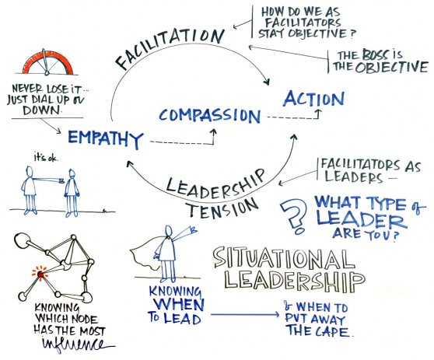
A Learning Leader; a Facilitative Leader.
Facilitative Leaders are capable of bringing out the best in those around them.
They have an authenticity to their leadership style, which encourages trust and commitment from others.
They model their values and principles every day in the way that they work and lead, their actions speak as loudly as their words in demonstrating their expectations to others.
(Taken from Questions of Difference)

Slide 7
Inspiring Others
What helped you learn from another person?
How were they “being”?
What did they say to you?
What were their actions?
How did you feel?
What did you see in them that inspired you? (be as specific as possible)
What does it mean to inspire others?

Slide 8
Know the Ingredients, Not Just the Recipe
Focus on relationships.
The secret recipe to inspiring a team (staff, volunteers, supporters) is to know the “ingredients” of the people you are inspiring. People want to know that their leaders understand their tendencies, aptitudes and behaviours well-enough to best work with and motivate them.
Leave ego behind.
If you really want to influence people, let your actions speak for themselves.
Ownership, Not Just Accountability
Holding others to account is a key component to sustaining performance momentum. However, when you can give your staff “ownership” in the process of defining how accountability is enforced – you inspire trust.

Slide 9
Know the Ingredients, Not Just the Recipe
Encourage Unity
Collaboration is an essential ingredient to an engaged and thriving team. Inspirational leaders know the strengths and weaknesses of their team.
Approachable And Inclusive
Approachable and inclusive leaders listen more than they speak, value diversity, welcome mistakes, reward originality and appreciate the unique differences of others.
Inspirational leaders know how vital it is to ensure each individual is treated fairly and respectfully, feels a sense of belonging and is psychologically safe. Therefore, creating a strong and inclusive team culture.

Slide 10
3 Ways Leaders Inspire their Teams:
1
2
3
Pushes for excellence in team
Leads with both “head” and “heart”
Cares as much about people as business
What does it take to be an inspirational leader? Inspiring your team is a whole-person effort, earmarked by traits like trust, humility and positivity. Here is a quick guide – and a little inspiration – on how to be a leader who inspires.

Slide 11
The Five Tenets of Leading a Team
If your team feel they can trust you, they will be more keen to communicate, express their ideas, and experience happiness in your organisation and a sense of belonging.
As a leader, it is okay to not have all of the answers. Step back and allow your team to trust that we can get there together if we can collaborate.
Feeling safe to fail is crucial as we need to feel safe that we can own up to our mistakes and understand what has gone wrong.
As a leader, it is really important that people know that questioning, challenging and suggesting new ideas is not only allowed, but is also encouraged.
Keep asking all your team for their input. Regular communication can help team members and leaders feel connected and engaged and enable the team to feel valued and listened to.
Establish Trust
Show Vulnerability
Fail Forward
Give Permission
Ask Questions

Slide 12
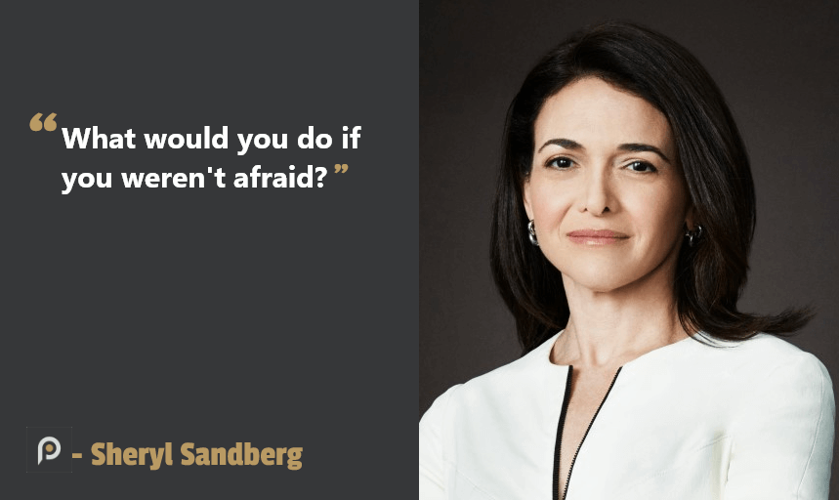
Summary of Key Ingredients for Inspiring Others:
Demonstrate Enthusiasm
Inspire Others by being Optimistic
Invest in others and understand emotions
Listen and Engage with others
Identify Shared Goals and Actions
Creates a Learning Culture
Open to being Solution Focused
Works transparently

Slide 13
Watch the video

Slide 14
How do you… Show up?
Lift others up
Never give up
Team up
Look up
Speak up
Show up

Slide 15
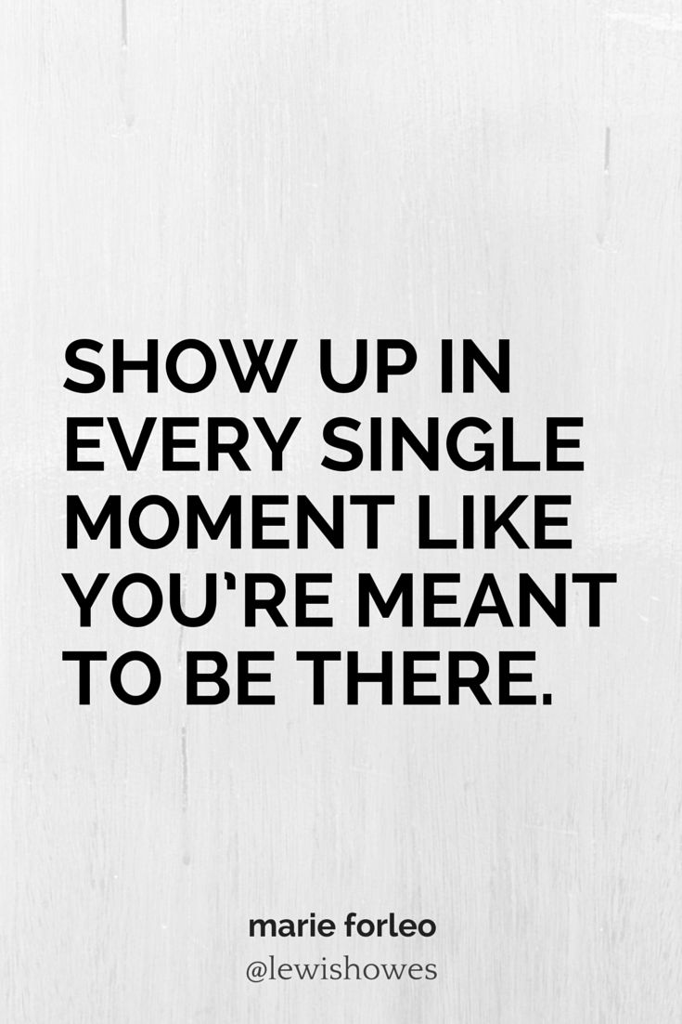
Reflection
How do you lift others up?
What are you an ‘expert enough’ in?
What energy do you create as a Leader?
How does what you do add value to others?

Slide 16
KEY TAKEAWAY
What's your thinking/key takeaway after this learning section?
What is your next step?
How will you begin?

Slide 17
Overcoming Barriers, the Glass Ceiling Effect and Stereotypes
02

Slide 18
“Be yourself. Everyone else is taken.”
- Oscar Wilde

Slide 19
Research suggests two types of factors combine in subtle ways to create roadblocks for women leaders: pull factors and push factors.
Read this fantastic whitepaper: Overcoming Barriers to Women’s Leadership and Unlocking the Power of Diversity,
by By Sophia Zhao, Center for Creative Leadership
Crtl + click

Slide 20
Challenges to Women’s Leadership:
Push & Pull = Fewer Opportunities
Push factors are externally driven – the limitations placed on women by others in their network, their organisation, and the society or culture.
Pull factors are internally driven – the limitations women place on themselves, pulling them away from leadership roles or actions.
The two are intertwined, as women respond to and shape their context.

Slide 21
Pull factors
Push factors
Push factors
“I made mistakes”
I’m not good at it.”
“I may fail.”
“My voice will not be heard.”
“I have family responsibilities.”
“I don’t want to be seen as bossy / aggressive / unfriendly / demanding”
“Women are emotional / weak / not ambitious”
“Society expects women to behave in a certain way.”
“The organisational culture is male-centric.”
“Organisations do not support women’s leadership development.”

Slide 22
Pull - Self-limiting thoughts
Compared to men, women are more likely to have self-limiting thoughts (the pull), such as: “I am not good at negotiation” or “I did not think I would get what I wanted” or “I don’t like negotiation.”
These beliefs align with the other challenges they reported, such as dealing with perfectionism, self-criticism, and imposter syndrome, or speaking about their own accomplishments.

Slide 23
Push - Social penalty of negotiating
Women were also more attuned to a social penalty of negotiating (the push). More than the men, they “didn’t want to be seen as difficult or ungrateful,” and many believed that “the negative social consequences of negotiation outweigh the positives of increased compensation.”
This negative social consequence is substantiated by research showing that women who negotiate are more likely to be perceived as demanding and not nice.
SOURCES: Overcoming Barriers to Women’s Leadership and Unlocking the Power of Diversity; Bowles, H. (2019). Why women don’t negotiate their job offers. HBR Ascend. (link)

Slide 24
Let’s contemplate. What messages does she believe?
Sanna Marin is the third Finnish woman since 2003 to serve as Prime Minister, but the youngest in such a role in the world today.
In 1907, Finnish women were the first in Europe to win full civil rights and the right to vote.
Today, the National Parliament is 47 percent female.

Slide 25
Taking control of Limiting Beliefs

Slide 26
Imposter Syndrome
1978: Psychologists Pauline Chance and Suzanne Imes
70 to 75% of people struggle with Imposter Syndrome at some point in their career
It is an inability to internalize accomplishments, attributing success instead to luck, timing or some external factor beyond their control
Those with Imposter Syndrome believe that they have tricked others into thinking they are bright and that it is only a matter of time before someone finds out

Slide 27
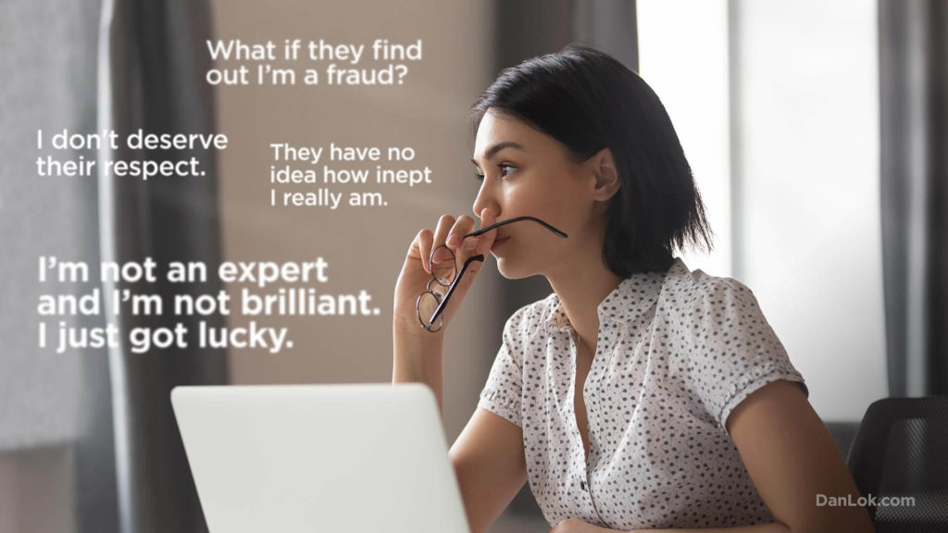
What solutions might help you to address Imposter Syndrome symptoms?

Slide 28
Reflections
Learn to take mistakes in stride
Push yourself to act before you’re ready
Force yourself to start, be that a project or initiative
Owning and celebrating achievements is essential
Start training yourself to veer away from external validation
SOURCES:
Beating the Impostor Syndrome by Portia Mount and Susan Tardanico
The Impostor Syndrome- Becoming an Authentic Leader by Harold Hillman Presence by Amy Cuddy
Trust, Self Compassion and Heartfelt Apologies by Brene Brown

Slide 29
Feeling confident – or pretending that you feel confident – is necessary to reach for opportunities. It is a cliché, but opportunities are rarely offered, they are seized.

Slide 30
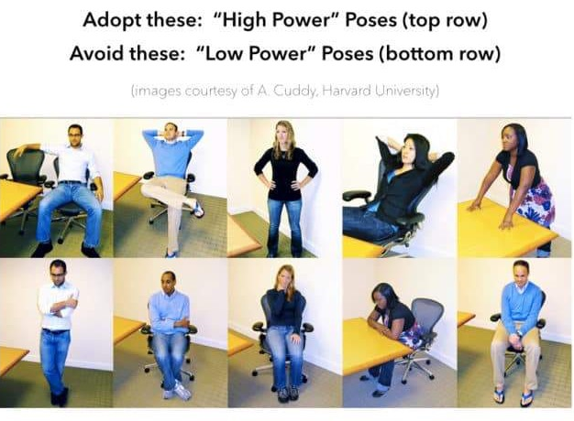
Confidence, Power Posing Techniques
Practice and apply your own power poses for your negotiations.
Standing tall gives you an immediate sense of personal and control, which boosts your self confidence.

Slide 31
A power pose is an expansive, confident body posture that makes us feel confident.
Photo by Samantha Hurley from Burst

Slide 32
Your Body Language Shapes You
By putting your body into Power Poses you can actually affect your own confidence and affect to others.
Our bodies change our minds, our minds can change our behavior and our behavior can change our outcomes.
Crtl + click
WATCH
Fake it til you make it!
Amy Cuddy, TED Talk, 2012

Slide 33
KEY TAKEAWAY
What's your thinking or feeling after this section?
What is your next step?
How will you begin?

Slide 34
Purpose and Finding Meaning in Work
03

Slide 35
“You don’t have to be somebody different to be important. You are important in your own right.”
-Michelle Obama

Slide 36
Purpose
Individual purpose can be thought of as an overarching sense of what matters in our lives. We experience purposefulness when we strive or work towards something personally meaningful or valued.

Slide 37
The more purposeful, open and empathetic the leader, the more likely that she can instil the trust necessary to encourage people to leave their comfort zones and explore how their purpose might be better met.

Slide 38
Research has shown there are three ways people can find meaning in their work.
Motives: What motivates you?
By focusing on tasks that align with your personal motivation you’ll find rich purpose in your work.
2. Strengths: We all love doing what we’re good at. Problem-solving, communicating, a particular set of tasks.
Becoming an expert in a particular area can create meaning. With a focus on a particular area, you’ll produce higher quality results. Results you can be proud of.
3. Passions: What are you passionate about?
What do you love to do? Do you love learning, tackling new problems? Teaching others? By focusing on what you enjoy you can cultivate more meaning in your day-to-day life.

Slide 39
You are enough.
The enoughest
enough
that ever
enoughed
Why focus on purpose?
96% Purpose Matters
According to DDI research, 96% of leaders say that purpose is critical to their job satisfaction.
People need to know what they are working for, and it is more than just a paycheck.
SOURCE: DDI Global Leadership Forecast 2018

Slide 40
Golden Circle Model: Sinek’s Theory Value Proposition
WATCH THE VIDEO

Slide 41
Start With Why – Simon Sinek looks at APPLE as an example…
Why – The Purpose
How – The Process
What – The Result
What is your course? What do you believe?
Apple: We believe in challenging the status quo and doing this differently.
Specific actions taken to realize the Why.
Apple: Our products are beautifully designed and easy to use.
What do you do? The result of Why. Proof.
Apple: We make computers

Slide 42
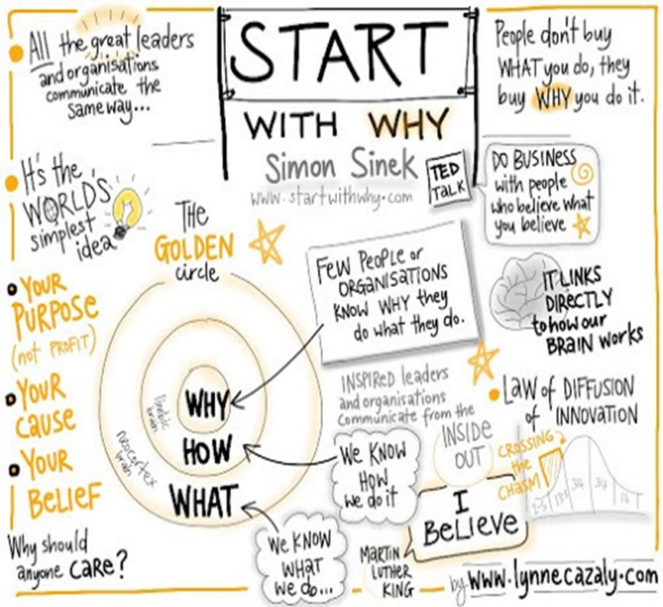
Reflections
What is your Why?
What do you love to do?
Why the role you do?
How are you at your best?
What helps you be at your best?
What gifts and talents do you bring to your role?
Where do you get, or what gives you, energy and motivation?

Slide 43
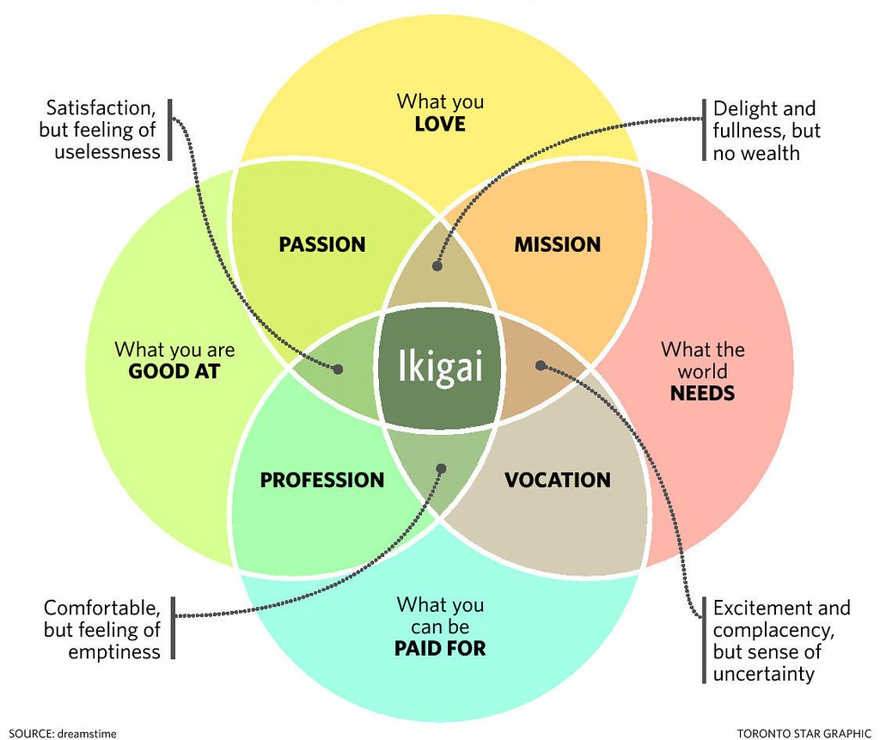
Ikigai
A Japanese concept referring to something that gives a person a sense of purpose, a reason for living

Slide 44
Now that you value your purpose as a leader and individual, let’s take a look at what meaning and success look like in the third sector organisation and initiatives you lead, or will lead

Slide 45
What is the meaning of your work and how to measure it?
Third-sector organisations have social missions and produce social impact.
That means they are helping members of society to improve their lives, in some specific areas.
Making this mission more specific is your task. To do that, it is important to understand and adopt terminology that is used to describe the work that results in improved living conditions for the target groups.

Slide 46
ADOPTING THIRD SECTOR TERMINOLOGY:
THE PATH TO FULFILLING WORK PURPOSE
INPUTS
OUTPUTS
OUTCOMES
IMPACTS
PURPOSE
The resources (such as donations) that the organisation acquires or attracts in order to fulfill its stated purpose.
The tangible goods and services that you develop
The stated and intended consequences of the commitments of resources. Effects of the outputs. Short-term, medium-term
Long-term, positive and negative effects of the initiative, or a project
Overall objective, a social mission, the reason you are doing what you are doing

Slide 47
KEY TAKEAWAY
What is your thinking or feeling after this section?
What is your next step?
How will you begin?

Slide 48
04
Resilience and Conflict Management

Slide 49
The capacity to manage the everyday stress of work while staying healthy, adapting and learning from setbacks and preparing for future challenges pro-actively. Kathryn McEwen
Your levels of resilience can change over the course of your life.

Slide 50
RESILIENCE
Nurture a positive view of yourself
Accept that change is a part of life
This is your macro-pathway towards resilience. These 5 elements should be adopted as your internal values and become your philosophy towards a more resilient living
Move towards your goals
Make connections
Take decisive action
strengthening female community leaders

Slide 51
Resilience
These are your micro daily steps to practice. Each step done is a success that brings you closer to your overall resilient living
Reframe
thinking
Clarify purpose
and meaning
Deepen
connectivity
Practice
positivity
Moderate
stress
Manage
emotions

Slide 52
Resilience: Falling and Rising Back Up – one of the most important things to learn in leadership
Dutch Olympic star Sifan Hassan completed a remarkable recovery to win her heat in the women's 1,500m in Tokyo after falling with just 380 meters of the race to go.
The long-distance runner's hopes of claiming a medal in the event appeared to be all but over after she was left as much as 25 meters off her fellow competitors with the finish line almost in sight.
Hassan was tripped over with less than a third of the race to go after another athlete tumbled to the ground just in front of her, resulting in an unfortunate tangle of legs.
WATCH HER VIDEO ON NEXT PAGE..........

Slide 53
Resilience: Falling and Rising Back Up – one of the most important things to learn in leadership

Slide 54
Resilience: Falling and Rising Back Up – one of the most important things to learn in life
How do you respond when you fall down?
What do you say to yourself?
What do you think?
What might you believe is true?
How do you pick yourself up?

Slide 55
What does resilience look like?
You, it looks like you!
By nurturing your
Behaviours
Attitudes
Thinking
Language – words, tone, eye contact and posture
you can become resilient, and perhaps you already are

Slide 56
Book recomendation
In Brené Brown’s book The Gifts of Imperfection, she discusses how to develop resilience. Brown says there are four requirements for developing resilience:
developing hope, combating societal expectations, refusing to numb negative emotions, and embracing spirituality.

Slide 57
What is a Resilient Zone?
A state of well-being in mind, body and spirit
When in the Resilient Zone one is able to handle the stresses of life
You can be annoyed or even angry, but do not feel like you will lose your head
You can be sad, but not feel like you will be washed away by the river of sorrow
Resilient Zone

Slide 58
Some have a very shallow Resilient Zone where even small stressors bump you out of the Zone.
Resilient Zone
Some have a deep Resilient Zone where there is a higher tolerance for a wide range of stressors.
Resilient Zone

Slide 59
What contributes to your Resilience?

Slide 60
SELF ASSESSMENT ACTIVITY
The following questions are designed to help you assess the resilience qualities that you carry with you– i.e. what do you have access to that enables you to flex in response to the demands of daily living and work. There are no right or wrong answers. Answer them by thinking of how you see yourself generally operating in the world.
How are you today? Take a few minutes and reflect.
Read the questions on the following slide and use the slide after that to rate your answers from 1 to 10, 1 being the least favourable outcome and 10 being the most favourable outcome.

Slide 61
SELF ASSESSMENT ACTIVITY
Flexibility - right now how flexible are you?
Confidence - are you able to hold your sense of ‘okayness’ regardless of things not going well?
Focus - scattering and trying to do everything
Managing thoughts - holding a growth mindset noticing the thought and recognising it.
Facing reality - how good are you at facing it.
Balance - hold a sense of identity when under pressure.
Reflection - have I used my energy wisely? Have I taken my time to think about the skills/qualities?

Slide 62
Contributing factor Dr Carole Pemberton | 1 | 2 | 3 | 4 | 5 | 6 | 7 | 8 | 9 | 10
Optimism I am optimistic about my life
Flexibility I don’t find it difficult to change my approach when something isn’t working or is no longer wanted
Support When I am struggling with something I talk to people who can help me
Purpose I know what I want from my career/life and why
Emotional control I can control my emotions when I am feeling pressured
Confidence (about self) My confidence is strong regardless of the immediate difficulties
Managing thoughts I hold a growth mindset noticing the thought and recognising it. I am able to challenge my thoughts when they undermine me
Balance I keep a sense of balance in my life even when I am dealing with tough stuff
Grit (determination) I stick at things once I commit to them
Notes:
The following questions are designed to help your assess the resilience qualities that you carry with you as you live your life – ie what do you have access to that enables you to flex in response to the demands of daily living and work.
There are no right or wrong answers. Answer them thinking of how you see yourself generally operating in the world.
How are you today? Take a few minutes and reflect….
Flexibility – right now how flexible are you?
Confidence – are you able to hold your sense of ‘okayness’ regardless of things not going well
Focus – scattering and trying to do everything
Managing thoughts- holding a growth mindset noticing the thought and recognising it
Facing reality- how good are you at facing it
Balance – hold a sense of identity when under pressure – gym etc..
Reflection – have I used my energy wisely? Have I taken my time to think about the skills/qualities…

Slide 63
A resilience practice
How’s my water level today?
How will I be intentional with noticing my level?

Slide 64
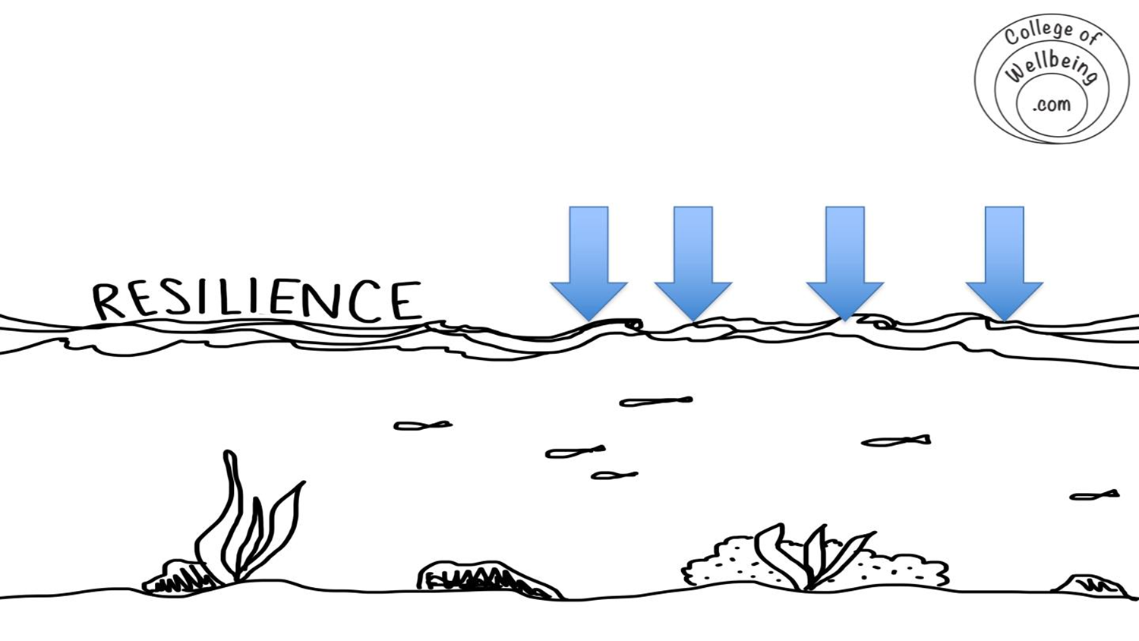
What factors push the water level down?
E.g. I tend to cope less well when ….

Slide 65
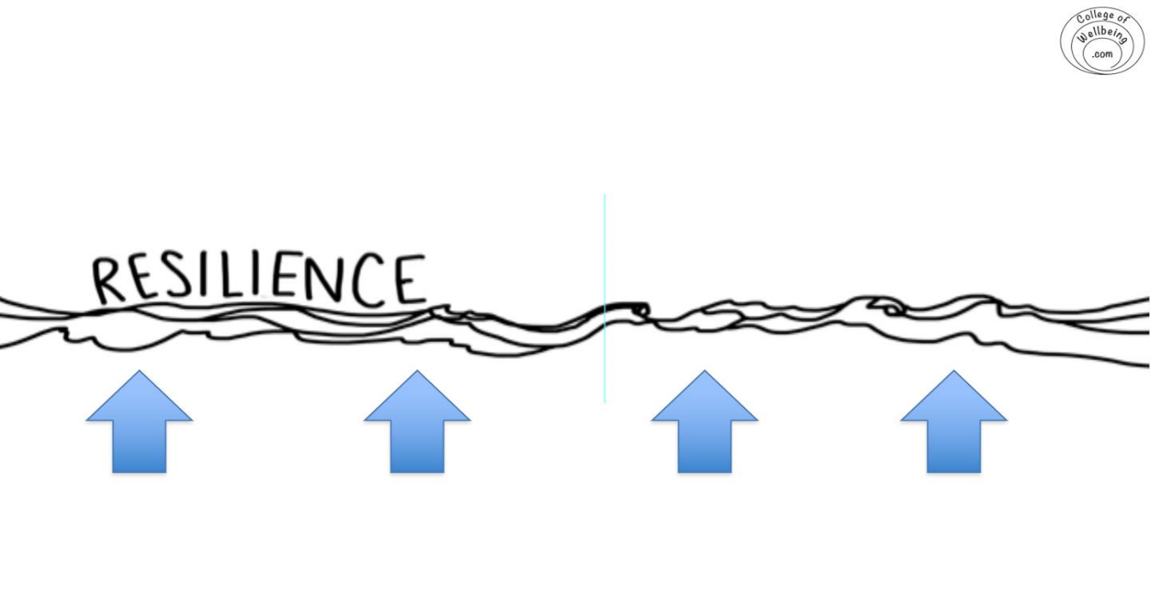
What can I do that nudges it upwards?
Notes:
Nichola

Slide 66
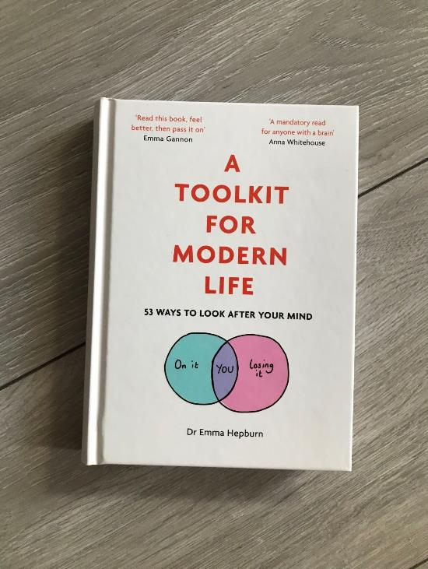
For your bookshelf
Crtl + click on each book cover to find it online

Slide 67
KEY TAKEAWAY
What's your thinking or feeling after this section?
What is your next step?
How will you begin?

Slide 68
Conflict Management

Slide 69
“Conversation between Adam and Eve must have been difficult at times because they had nobody to talk about.”
- Agres Repplier

Slide 70
Conflict in the 3rd Sector Organisation
Conflicts in organisations are an inescapable aspect of organisational life.
Nonprofit organisations present a particular type of cultural and institutional base. Because their commitment is to a specific social mission, their members are primarily interested in and motivated by the organisational mission and by their wish to contribute to make the world a better place.
The distinct cultural and institutional base, making up “the social” in nonprofit organizations, influences how conflicts are conceptualised, addressed, and dealt with in such organisations.
SOURCE: Conflict and Sensemaking Frameworks in Nonprofit Organizations: An Analysis of the Social Meanings of Conflict Elisabeth Naima Mikkelsen; agepub.com/journalsPermissions.nav, DOI: 10.1177/0899764012465674, http://nvsq.sagepub.com

Slide 71
Conflict Spiral

Slide 72
Sensemaking: a Way of Overcoming Conflicts
Conflict sensemaking is the process of framing, or organising experience through a certain way of defining what is going on in a situation (Goffman, 1974).
This process occurs retrospectively, when people bracket their experience and give it meaning (Weick, 1995; Weick, Sutcliffe, & Obstfeld, 2005.
This is a way of thinking, that leads to making sense of things and situations, and understanding them better. Making sense of conflicts helps understand them, even accept that they are a reality, and manage them.
SOURCE: Conflict and Sensemaking Frameworks in Nonprofit Organizations: An Analysis of the Social Meanings of Conflict Elisabeth Naima Mikkelsen; agepub.com/journalsPermissions.nav, DOI: 10.1177/0899764012465674, http://nvsq.sagepub.com

Slide 73
Sensemaking: WATCH THE VIDEO

Slide 74
Sensemaking for conflict management
Can you make sense out of SENSEMAKING?
You could use it to understand and manage conflicts. Examine…..
How often is the conflict happening?
What is the perceived cause? Who is involved?
How do all involved feel?
Could there be an underlying cause?

Slide 75
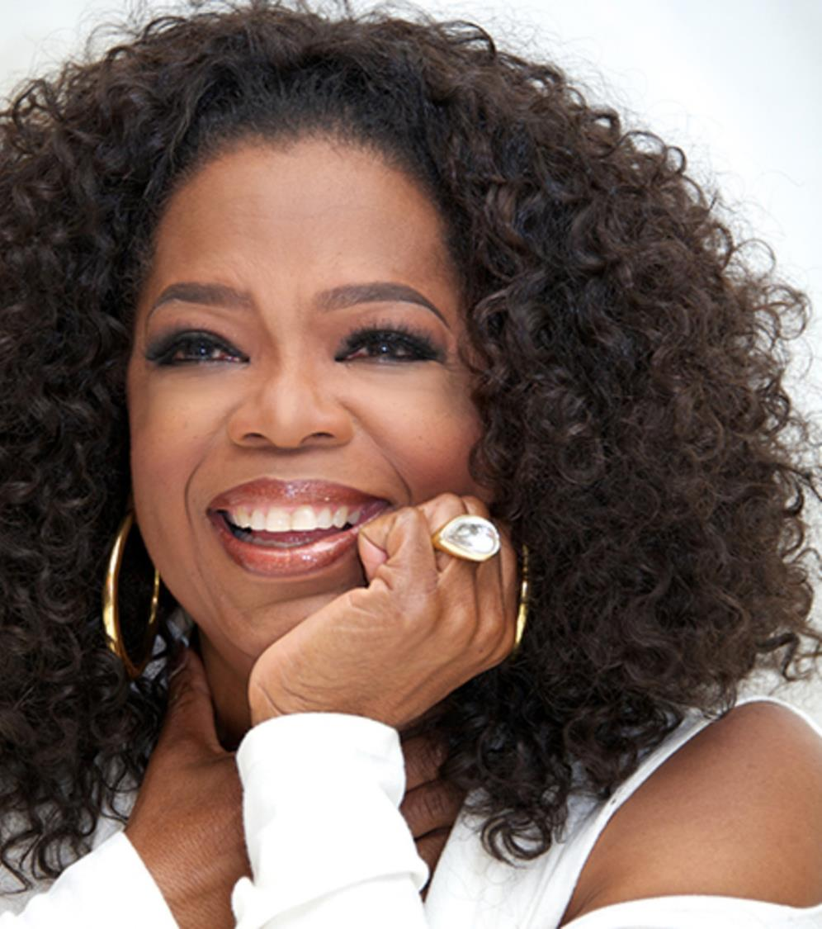
‘I am a woman in process. I’m just trying like everybody else. I try to take every conflict, every experience and learn from it. Life is never dull’
Oprah Winfrey

Slide 76
Conflict Escalation – spot the conflict and intervene
IMAGE SOURCE: itadvisory.dk, Kristian Sørensen, CEO and Sr. Principal at IT ADVISORY, Kristian Sørensen is CEO and Sr. Principal at IT ADVISORY, https://itadvisory.dk/conflict-escalation-spot-the-conflict-and-intervene/

Slide 77
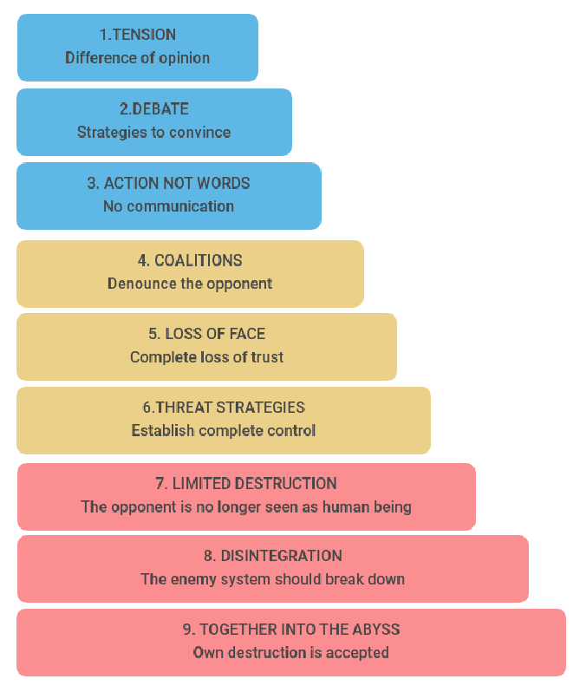
Conflict Escalation
Steps 1-3: At this level, the conflict has to do with the case (the facts)
Steps 3-6: The focal point of the conflict shifts from attention on the facts to the relationships between the parties involved
Steps 7-9: At this stage, the conflict is getting out of control and none of the parties are able to see a solution for the situation
IMAGE BY: CONFLICT DIAGNOSIS By Karin Sonnleitner and Verena Gschweitl
SOURCE: itadvisory.dk, Kristian Sørensen, CEO and Sr. Principal at IT ADVISORY, Kristian Sørensen is CEO and Sr. Principal at IT ADVISORY, https://itadvisory.dk/conflict-escalation-spot-the-conflict-and-intervene/
Reference: Friedrich Glasl: Konfliktmanagement. Ein Handbuch für Führungskräfte, Beraterinnen und Berater. Haupt, Bern 9. A. 2009

Slide 78
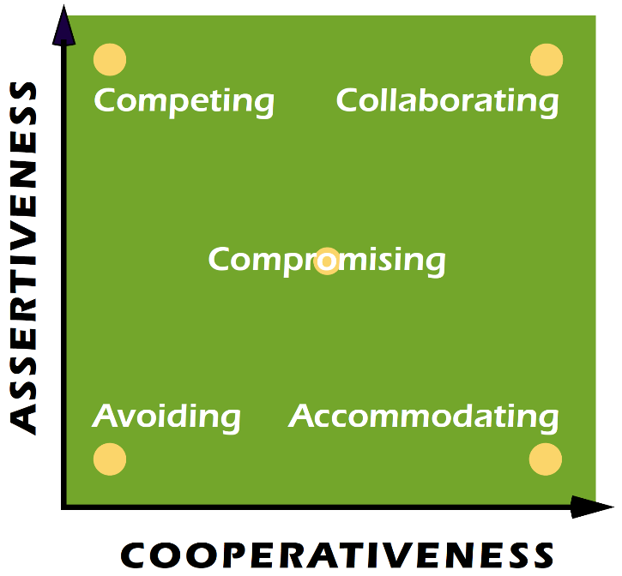
Exercise
What do you see as your dominant conflict management style?
What is it for those that you work closely with?
Reference: Thomas, Kenneth W.; Kilmann, Ralph H. (June 1978). "Comparison of Four Instruments Measuring Conflict Behavior". Psychological Reports.

Slide 79
Five Common Conflict Management Strategies
4
2
5
1
3
Accommodate
Compete
Compromise
Collaborate
Avoid

Slide 80
Listening is prevention and the solution
If we’re honest, many of us are just waiting to talk most of the time when we are listening to others. This can be even truer when we are having difficult conversations.
Slow things down
Ask open ended questions
Stay still
Anchor - Put tongue to the roof of your mouth
Repeat each word back in your own head
Use silence
"Most people do not listen with the intent to understand; they listen with the intent to reply.“
Stephen Covey

Slide 81
Go to the balcony
“Imagine you are negotiating on a stage and then imagine yourself climbing onto a balcony overlooking that state. The Balcony is a metaphor for a mental attitude of detachment.”
Source: Ury, W. (1991). Getting past no, New York: Bantam Books.

Slide 82
Negotiation Strategies
05

Slide 83
Negotiation Skills
What skills does a great negotiator need?
Some skills to reflect on:
Effective speaking
Effective/active listening
A sense of humour
A positive attitude
Respect
Self-confidence
Emotional intelligence
Persistence
Patience etc.
An ability to influence

Slide 84
Read and learn
Click to read “Good Leaders Are Good Mediators” by Maria Simpson
Maria has taught in the graduate program on Negotiation, Conflict Resolution and Peacebuilding at California State University Dominguez Hills for over ten years and was a mediator for the Los Angeles County Superior court for over 15 years. She has also taught communications and leadership at Antioch University Santa Barbara and conflict resolution in the mediation certification program at the University of California Santa Barbara.

Slide 85
Two types of negotiations
Characteristic | Distributive | Integrative
Goal | Get all the pie you can get | Expand the pie
Motivation | Win-Lose | Win-Win
Focus | Positions | Interests
Information Sharing | Low | High
Duration of Relationship | Short-Term | Long-Term

Slide 86
1
Think about your perceptions of the other person or party
Negotiating? Be Prepared!
Preparation is key when negotiating to ensure your best outcome.
How do you prepare for a negotiation?
2
Clarify your aims
3
Gather information – do your homework
4
Negotiate internally with your own side first
5
Prepare the setting
6
Prepare yourself mentally and decide who goes first.

Slide 87
Common Negotiation Mistakes
Being underprepared
Assuming that everything is ok
Giving in too quickly
Letting emotions get the better of us
Overconfidence
Being too fixed in your approach
Not asking targeted questions (5Ws: Who? What? Where? When? and Why?)
Assuming that cross-cultural negotiations are like “local" negotiations
Relying on past performance ‘it worked last time’

Slide 88
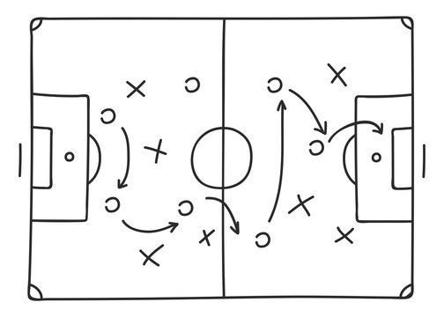
Understand tactics used by others, we do not recommend you use them, but here is the list so you can recognise them
Flinching
The better offer
Referring to a high authority
Good cop/Bad cop routine
Using silence
“The Columbo” – one more thing…
Being belligerent/ Stonewalling
Urgency ‘But I need it now!’

Slide 89
5 simple tactics which will help you to be more effective
3
5
Talk less
4
Be patient and show it
Keep your cool
1
Listen more
Show empathy
2

Slide 90
Power in Negotiations?
Power in negotiations is important because.
People believe it is important – and perception is important
It can affect the ability of the negotiators to make decisions
Usually, the side with the most power (whether perceived or actual) is likely to achieve more of what they want

Slide 91
Knowing and maintaining your sources of negotiation power
Negotiating power generally comes from one of three sources:
Having clearly defined aims and a desired outcome from the outset
Role power
Psychological power
When preparing for a negotiation with a powerful counterpart, try to increase your own sense of power on as many of these levels as possible.
Above all believe in yourself.

Slide 92
Negotiation Strategies
Be objective!
Focus on using objective criteria and facts in your negotiations.
These will be actual pieces of information, independent of the parties in the negotiation, that are relevant to what should or should not be agreed to in that negotiation.
Try to avoid subjective criteria, which draw on emotional elements such as views, feelings, and judgments.
Objective criteria are: Independent of either side’s position; applicable to both sides; practical and credible.

Slide 93
Negotiation Techniques
Four simple practical steps can help to boost your mindset and improve your outcomes when negotiating
Source: Katie Shonk Harvard Law School 5 Good Negotiation Techniques 5.11.20

Slide 94
1
Reframe
Feeling daunted or worried at the prospect of a meeting to discuss or negotiate?
Reframe this as excitement.
This simple positive mindset shift switches anxiety into a forward-thinking state, boosting your outlook and confidence.
Source: Katie Shonk Harvard Law School 5 Good Negotiation Techniques 5.11.20

Slide 95
Anchor - Try that first offer
2
Studies by psychologists Amos Tversky and Daniel Kahneman show the negotiator making the first offer is likely to have the greatest leverage in a debate.
Consider making the first offer to get the negotiation moving and back this up with the relevant document trail.

Slide 96
Apply the power of silence
3
In negotiation, as in any discussion, we tend to rush in to fill any uncomfortable silences
After your counterpart speaks, allowing a few moments of silence to settle can give you time to fully absorb what they just said. “Silence gives you the ability to dampen your instincts for self-advocacy and amplify your instinct to listen,” according to Harvard Business School and Harvard Law School professor Guhan Subramanian

Slide 97
Ask for Advice
4
In a recent study (Brooks Wharton School Professor Maurice Schweitzer, and Harvard Business School Professor Francesca Gino), participants rated partners who asked them for advice to be more competent than partners who didn’t ask for advice/
When we ask for advice, we flatter the advisor and boost her self-confidence, the researchers discovered. So, consider taking opportunities to ask your counterpart for advice when you truly need it.

Slide 98
Exercise
Imagine yourself at the end of a successful negotiation.
What will the other side’s victory speech to their constituents need to address? What will they have to have in order to claim their victory?
Now think about a negotiation you have coming up, how will you approach this?
Take 15 minutes and quickly list the key outcomes you wish to achieve, the possible objections and your plan to overcome these to be successful.

Slide 99
Letting Everyone Be Themselves, Whilst Striving to a Mutual Vision
06

Slide 100
“Letting People Be Themselves Is The First Step To Building An Ethical Culture”
Creating conditions that foster both ownership and authenticity in an organisation is an example of authentic leadership
Authentic leaders have a deep understanding of their personal values and ethical principles, as well as genuine awareness of their weaknesses and strengths (researchers call this “optimal self-esteem”).
The quote above is by Mary Barra, the chairperson and CEO of GM, and the first female CEO of a major global automaker

Slide 101
“Create a vision and never let the environment, other people’s beliefs or the limits of what has been done in the past shape your decisions.” – Tony Robbins
Leadership and vision aren’t just partners – they’re one and the same.
Leading without vision is like driving a car blindfolded: You just wouldn’t do it.
You cannot lead the way without seeing where you’re going.

Slide 102
Your Vision
Vision acts as an internal force propelling a leader to act. It provides a leader an objective. The consistent existence of a vision makes a leader progressive despite various hardships and obstacles. Vision is a bond that unites the individuals into team with a mutual goal.
Let’s look a bit more closely at the four key components:
A compelling story of the future is engaging; it captures the heart, forces you to pay attention. Those who hear it want to be a part of it somehow. And they are moved.
What does your future look like – what’s the image? If others could travel into the future with you, what would they find? A well-crafted leadership vision is described in concrete terms that are easy to visualize and remember.

Slide 103
Your Vision
The story of your future should be a stretch, but it must be achievable, too. If it were not achievable, you would have little motivation to even bother trying.
Finally, future simply means out there – some time from this moment forward, but not so far away that’s it’s out of reach.

Slide 104
THEY GIVE RECOGNITION
THEY CONNECT THE RIGHT PEOPLE
THEY DON’T MICROMANAGE
THEY CREATE SAFE ENVIRONMENTS
FOCUS ON THE PERSON’S STRENGTHS
THEY EMPATHISE
How great leaders behave:

Slide 105
KEY TAKEAWAY
What is your thinking or feeling after this section?
What is your next step?
How will you begin?

Slide 106
Congratulations!
THANK YOU for finishing the final Module 6 of the Shine Open Education Resources.
We are confident you are on your path to thriving as third sector leader ☺.
www.shineproject.eu

